Slide 1

Management of Mass Casualties – national response and guidance
James Hebdon
EPRR Portfolio Manager
8 June 2018

Slide 2
Background
Event | Year | Location | Fatalities | Injured
Terrorist attack on the World Trade Centre | 2001 | NYC, USA | 2,993 | 8,700
Multiple bombings on a transport system | 2004 | Madrid, Spain | 191 | 1,900
Multiple bombings on a transport system | 2005 | London, UK | 52 | 650
Marauding terrorists with fire arms | 2008 | Mumbai, India | 166 | 293
Marauding terrorists with fire arms and bombing | 2011 | Oslo, Norway | 85 | 176
Marauding terrorists with fire arms | 2013 | Nairobi, Kenya | 67 | 175
Marauding terrorists with fire arms and bombings | 2015 | Paris, France | 130 | 368
Terrorist with fire arms | 2016 | Orlando, USA | 49 | 53
Vehicle borne terrorist with fire arm | 2016 | Nice, France | 84 | 308
Bombing and fire | 2016 | Bagdad, Iraq | 326+ | 246

Slide 3
Concept of operations for managing mass casualties

Slide 4
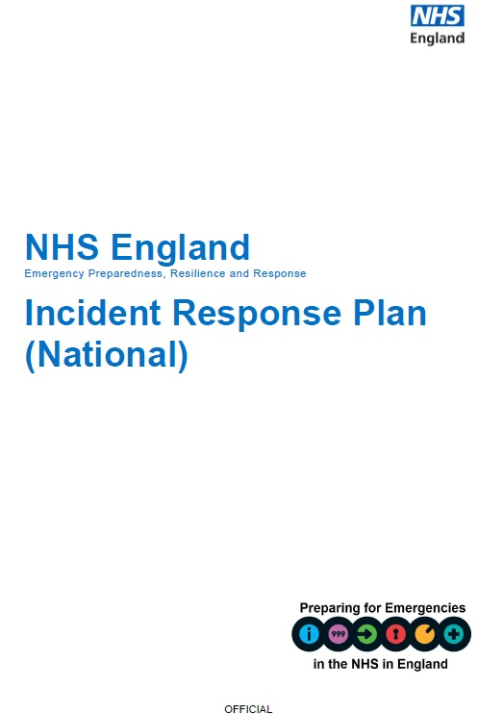
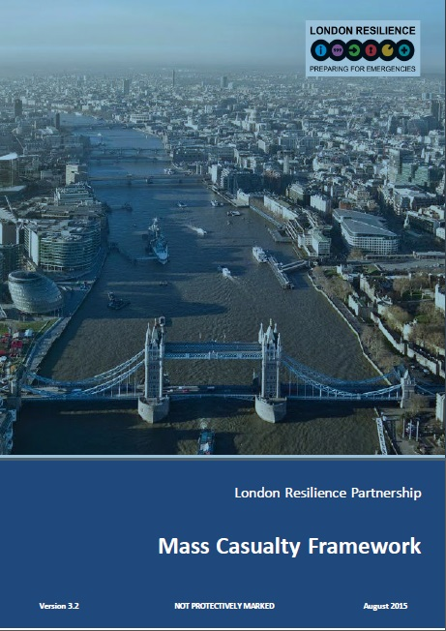
Command and control
Establishment of national, regional and local command and control arrangements across the health landscape
Wider resource support from local government and national asset mobilisation
Immediate stand up of four hospitals (minimum) expanding out from the incident scene
Notes:
252A and the establishment of ICCs and Logistic Cells
Support from NHS Supply Chain
Urgent supplies
Management of stock
Staffing assets
Support from specialist advisors
Blood Stocks
Management of stock
Maintaining supplies

Slide 5
Operational Management
Clinical Cell
  Clinical Advice and oversight
  Formed of the National EPRR Clinical Reference Group
  Specialists co-opted as needed
Logistics Cell
  Controlled access to emergency stock
  Coordinate with regional cells in the management of equipment
  Supported by NHS Blood and Transplant and NHS Supply Chain

Slide 6
Use of Section 252A
Formal letter from Simon Stevens to Secretary of State for Health
  Requires organisations to follow the direction of NHS England in an emergency
  Doesn’t apply to NHS Blood and Transplant and other arms length bodies
Section 253 – used by SoS to direct the NHS through NHS England

Slide 7
Service response
Area 3
Area 1
Area 4
Area 2
Notes:
Use of Areas to provide support and patient distribution – incidents occur in area one, the Emergency Operations Centre beings to distribute patients from Casualty Clearing into the Trauma Centres and Units available in their area. They then contact adjacent Areas (2/3) to provide beds and ambulance assets to support the response coordinated through the NACC (building at top) Area 4 remains available to support and provides some business as usual coverage for Areas 1-2-3 to allow the response to be adequately resourced. EOCs remain responsible to contact with their receiving units and communicating this between EOC and the NACC.

Slide 8
Scene management
Casualty Clearing Stations to stabilise and distribute patients appropriately
Advanced medical support provision at the scene
Consumables and equipment supplied to scene to support delayed patient transfers
Establishment of walking wounded treatment facilities close to the scene
Mobilisation of staff from community based nursing and general practice
Notes:
Blood stocks via Air Ambulances that already carry stocks, and request via hospital blood ordering processes.

Slide 9
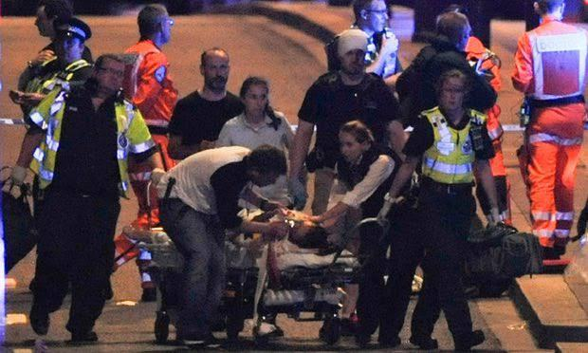
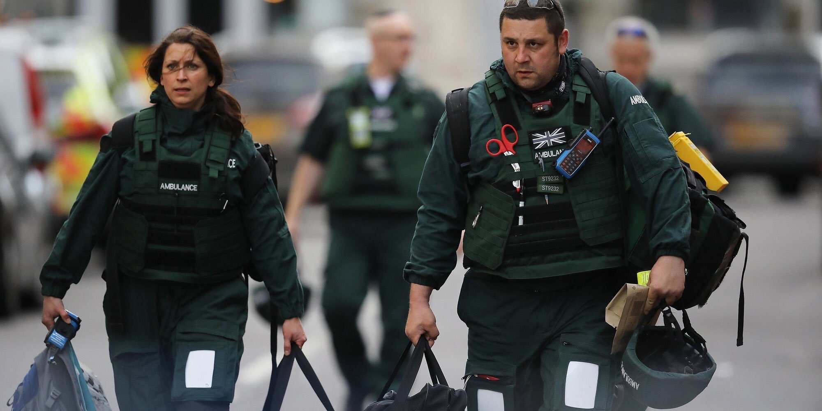

Right Patient, Right Care
Major Trauma Centres to manage the most seriously injured and assessment of patients into specialist centres (e.g. burns)
Trauma Units used to treat lower priority patients or stabilise those seriously injured for movement into specialist care centres
Use of Air Ambulance assets to move patients to out of area care settings or mobilise specialist staff to hospitals or scene
Support from private providers under contractual obligations and mutual aid agreements
Specialist care centres to provide advice and support into responding hospitals

Slide 10
Specialist Management - Burns
Establishes how the burns services will work together in a large burns incident
  Assumes patients in the trauma pathway
  Closure to direct referral
  Burns Teams to assess patients in Trauma Centres
  Most appropriate patients moved into capacity

Slide 11
Long term care
Intermediate term use of surgical capacity for continued management and reconstructive surgery
Long term use of reconstructive and therapy services, especially in areas such as burns
Psychological support required for years and decades following the incident, including for those not directly affected
Notes:
Psychological support – supporting those that have been impacted by similar events previously and the new event retriggers trauma.

Slide 12
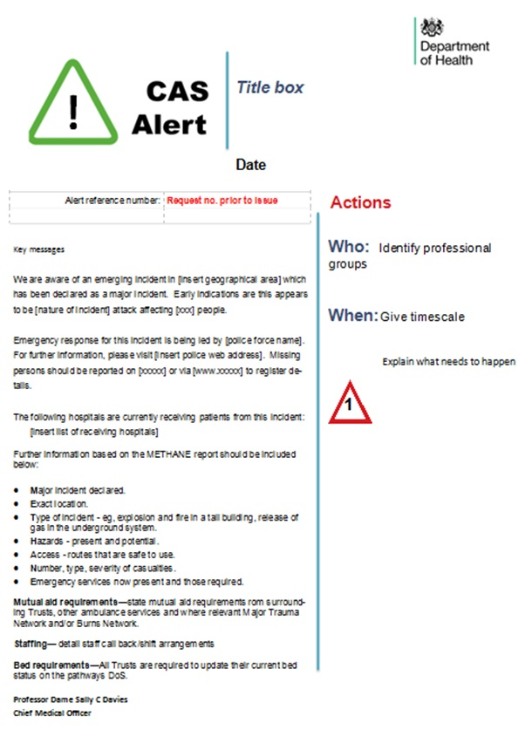
Communications
NHS Choices incident page
Use of Central Alerting System (CAS)
Public and staff messaging coordinated by a Communications Cell

Slide 13
Clinical Guidance

Slide 14
CBRN incidents: clinical management and health protection
Update to the guidance published by Health Protection Agency in 2008
PDF format
Provides guidance for:
  Chemical exposure incidents
  Biological hazards and incidents
  Radiation incidents
Includes patient management guidance and appropriate PPE for the incident type
Contact information for further support and advice

Slide 15
Clinical Guidelines for use in major incidents
Provides guidance on the management of injuries from incidents
Allows for treatment in settings unfamiliar with injuries
Information is provided from both NHS and military learning from management of injuries
Due summer 2018
Notes:
2 yearly updates?

Slide 16
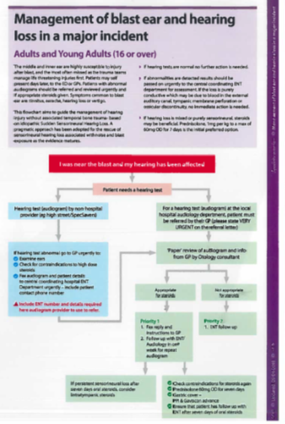
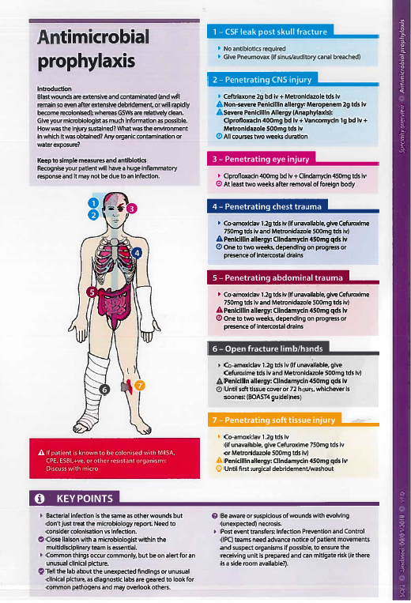
Sample pages

Slide 17

Questions

