Slide 1


MAJOR INCIDENT – TRIAGE
Suzan Thompson
Senior Lecturer
MSc – Inter-professional Practice (Civil Emergency Management)
HMIMMS Instructor.

Slide 2
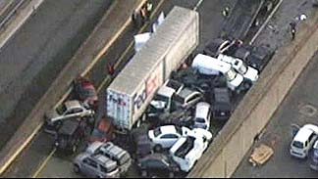
Where to Start?
Notes:
Structure
Control

Slide 3
The Structured Response - CSCATTT
Command and control
Safety
Communication
Assessment
Triage
Treatment
Transport

Slide 4
‘Triage is the Keystone of Good Disaster Medical
Management’
(Hogan and Burnstein 2002. Pg 10)
Notes:
‘Correct and accurate Triage is crucial and has a profound effect on the management of disaster victims’ (Kennedy et al 1996, Pg. 136), and has been advocated to be the most important medical task performed at the disaster site (Kennedy et al 1996, Frykberg E & Tepas J 1988, Burkle et al 1994).

Slide 5


Triage
The assignment of degrees of urgency to wounds or illnesses to decide the order of treatment of a large number of patients or casualties
To Sieve or to Sort
Notes:
Triaging in a disaster, requires a paradigm shift on the part of the practitioner, from providing the highest intensity care to the sickest victims to do the greatest good for the greatest number, this makes triaging stressful (Sanner 1983, Arbon et al 2006)), and emotional (Fry and Burr 2001),
Should be applied whenever the number of casualties exceeds the number of skilled rescuers available

Slide 6

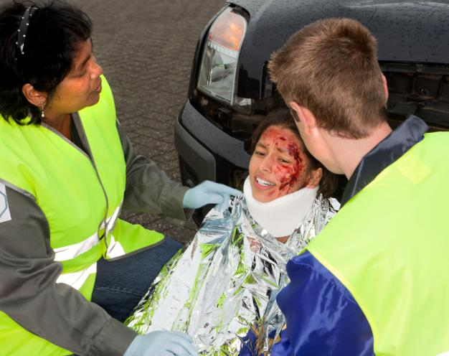

Aims of Triage
Notes:
This slide is animated
Right patient
Right place
Right time
Do the most for the most
Cornerstone of military medicine.

Slide 7
Timing
Dynamic Process (continuous)
  At Scene
  At CCS
  Prior to evacuation
  Hospital reception
  During resuscitation
  Prior to surgery
  Prior to admission to ICU / Critical Care Area.

Slide 8
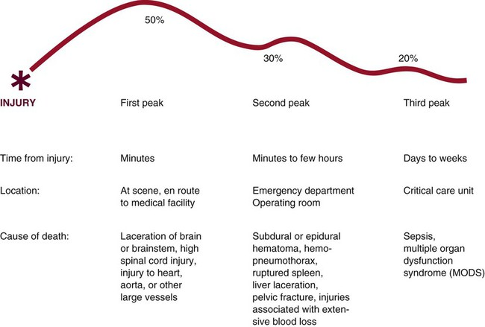
Trimodal Distribution of Death.

Slide 9


Triage Priorities
Priority 1.
Immediate Category
Casualties require immediate life-saving treatment.
Priority 2.
Urgent Category
Casualties require significant intervention as soon as it can be given
Notes:
4 Categories Used / Recognised – but only 3 normally used.

Slide 10
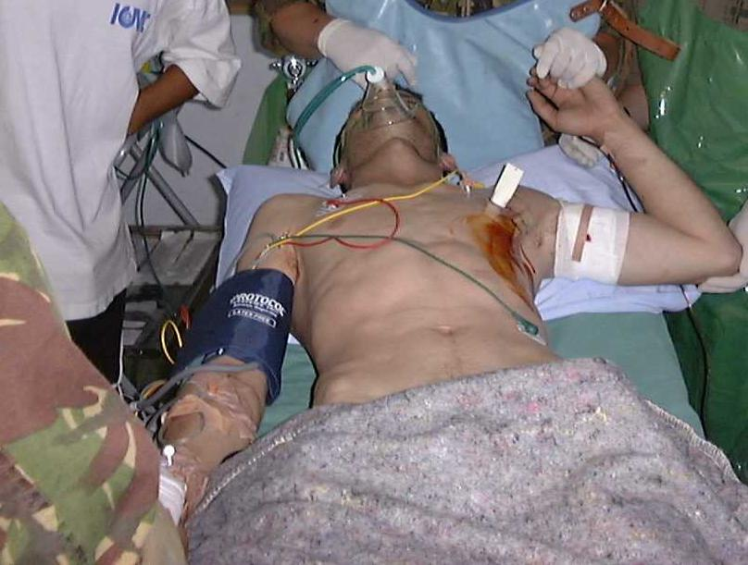
Priority 1 (Immediate)
Notes:
Casualties who require immediate life-saving interventions.

Slide 11
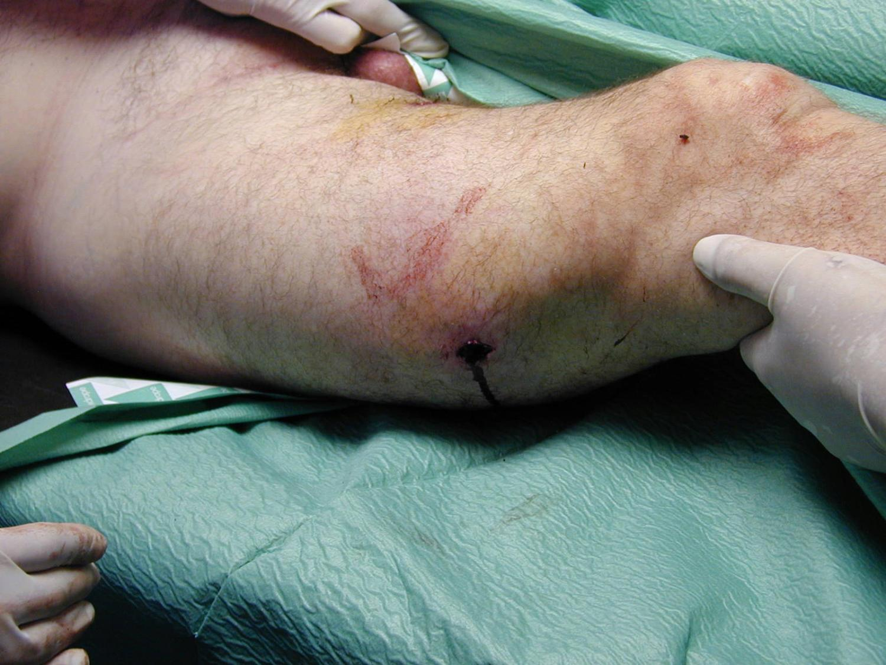
Priority 2 (Urgent)
Notes:
Casualties who require surgical or other interventions within 2 - 4 hours.

Slide 12

Triage Priorities
Priority 3.
Delayed Category
These patients will require medical interventions but not urgently.

Slide 13
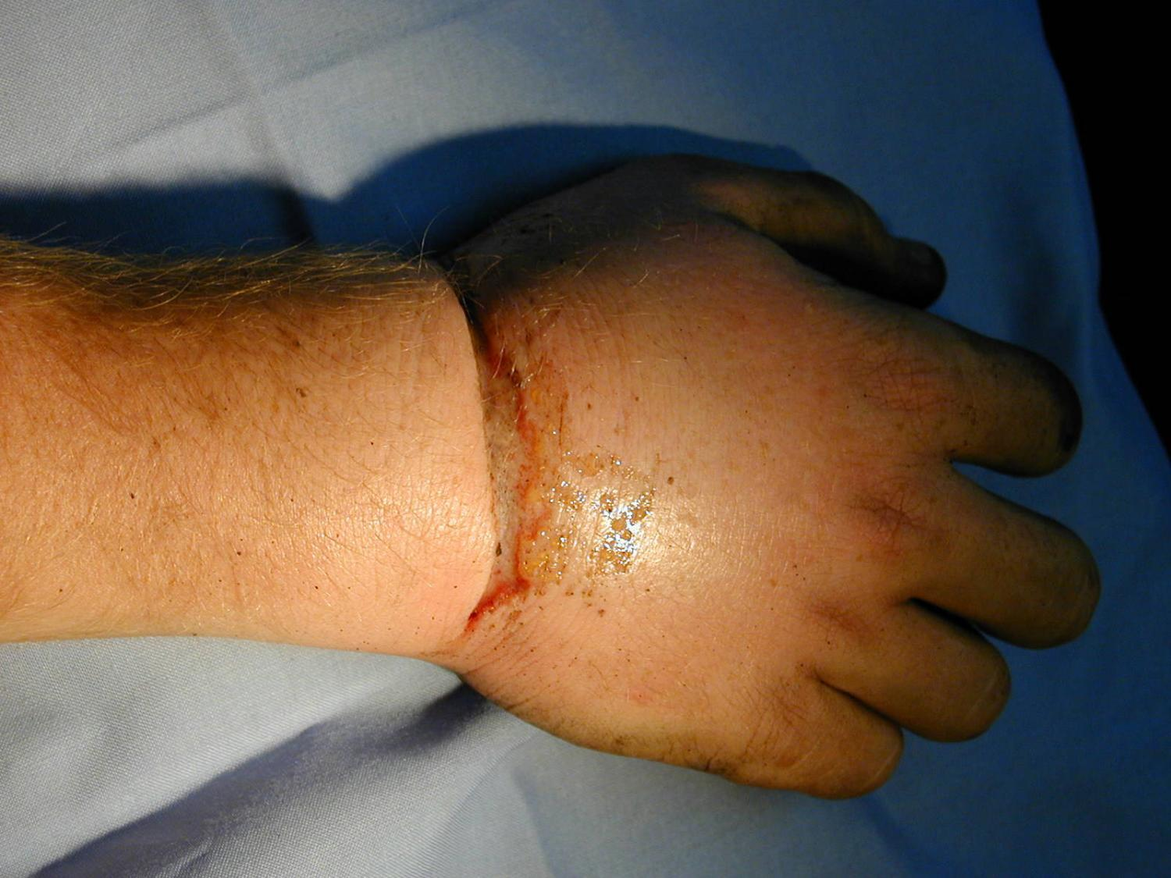
Priority 3 (Delayed)

Slide 14

Triage Priorities
Priority 4
Expectant Category.
Patients who are so severely injured that any attempts to treat them would have very little chance of a successful outcome.
Has never been used invoked in a UK Major Incident.

Slide 15
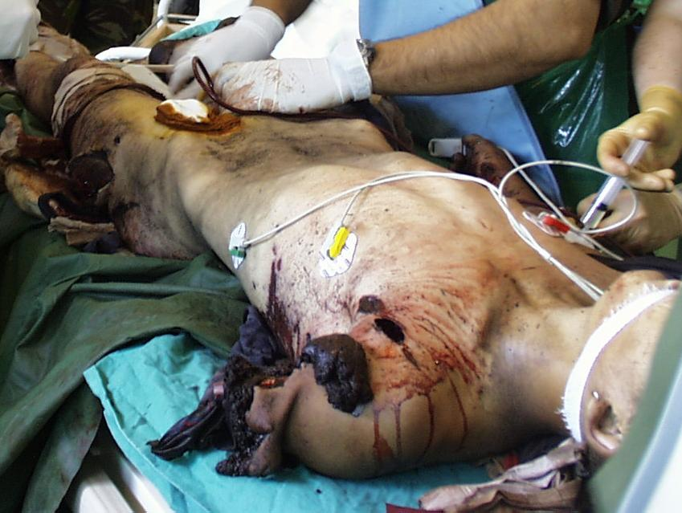
Priority 4 (Expectant)

Slide 16
Triage - Methods
Reliability
Validity
  Over-Triage
  Under-Triage
  Physiological v Anatomical
Triage Sieve (primary)
Triage Sort (secondary)
Notes:
Having established the triage categories it is necessary to provide a reliable method of triage so that all users will come to the same triage decision
Reliability means that the instrument is used to assess something in a reproducible way.
The validity of an instrument relates to its ability to assess what it is intended to assess.
The main determinants of triage accuracy are under triage and over triage.
Under triage occurs when patients with life-threatening injuries are taken to non-trauma centres
Triage protocols should aim to keep under triage below 5%
Over triage occurs when patients with injuries that are not life threatening are taken to designated Trauma centres.
Triage protocols should aim to keep over triage below 50%
Physiological v Anatomical
Limitations:
Patient have to be undressed to see the injuries: this is time consuming and impractical.
Decisions are poorly reproducible between observers with different experiences.
Life-threatening injuries may not be detected by examination alone.
Physiological triage relies on detecting changes in vital signs as a result of injury or illness – these systems are more objective
The Triage Sieve and Sort are both physiological methods
However where there is an experienced operator, knowledge of the clinical condition may be used to upgrade a triage category.

Slide 17
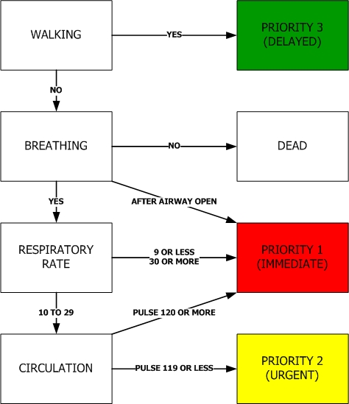
Triage Sieve
©ALSG, 2012
Notes:
Supported by the paediatric triage tape if required.
Initial Triage decisions need to be made quickly, safely and reproducibly.
Mobility – if walking T3 delayed
ABC Assessment

Slide 18
NARU – Triage Sieve
Notes:
NARU Triage Sieve – post 7/7/2005 – Rule 43 Justice Hallett
Acknowledged that since Ambulance Trusts were now using CABCDE to assess patients the Triage sieve needed to reflect this

Slide 19
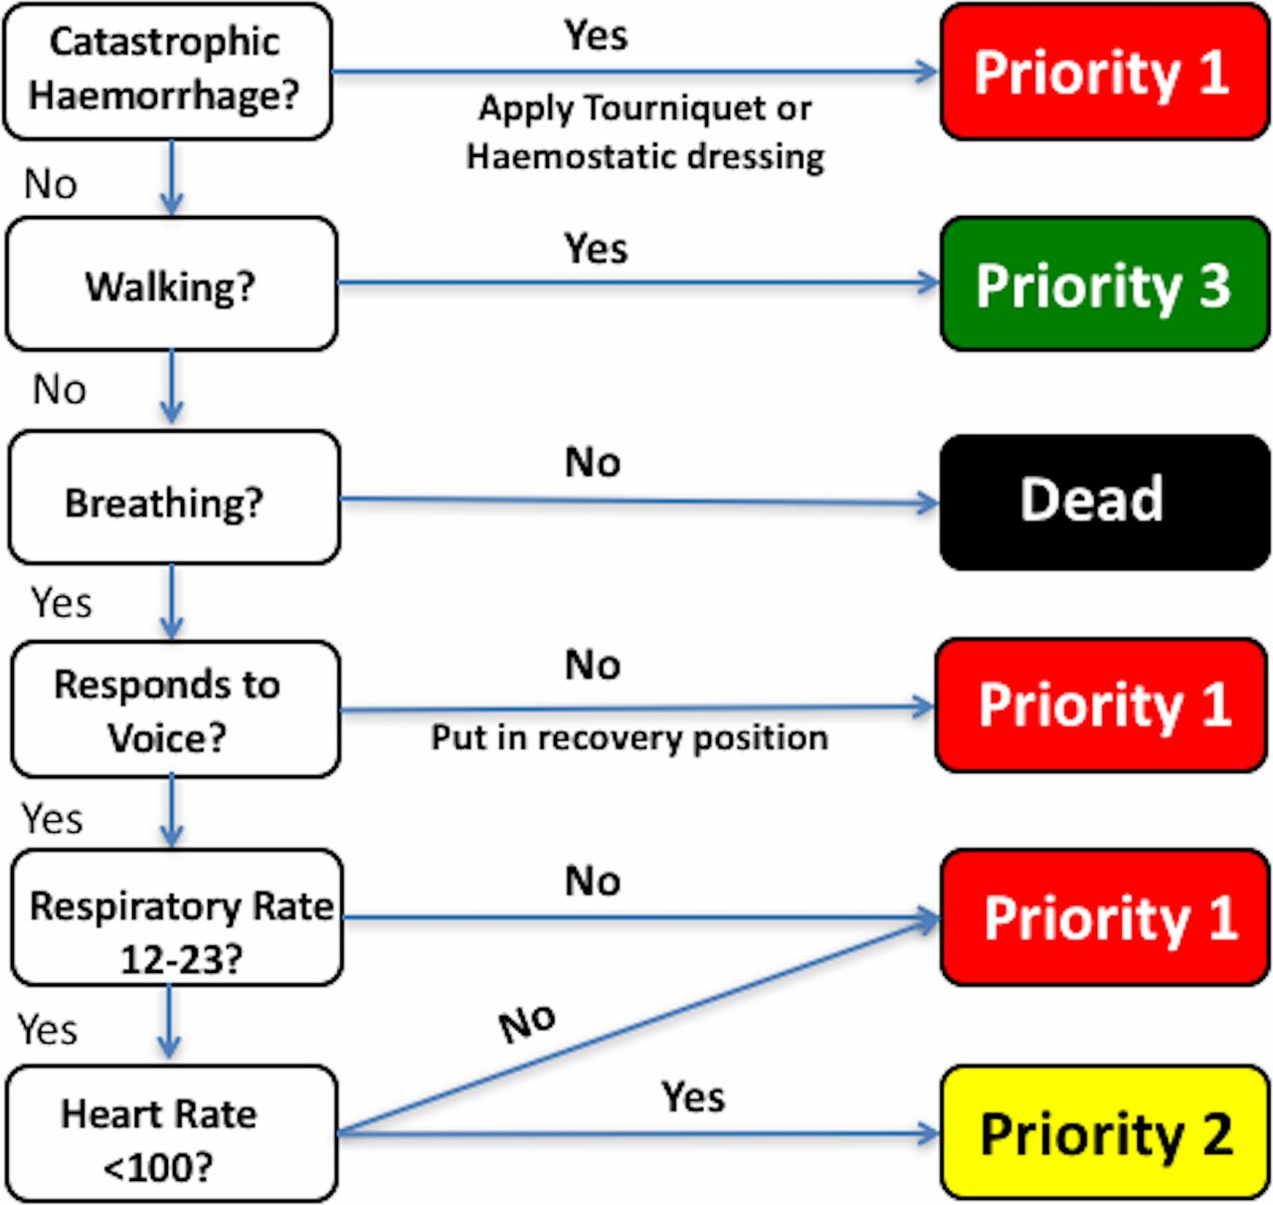
MPTT - 24
Notes:
The Modified Physiological Triage Tool (MPTT) was derived on a military cohort using logistic regression and outperforms all existing triage tools at predicting the need for life-saving intervention in both military and civilian populations.
►► Increasing the upper respiratory rate threshold to 24 (MPTT-24) allows for a reduction in the time required to use the triage tool.
►► Using the Alert; responds to Verbal stimulus; responds to Painful stimulus;
Unresponsive (AVPU) scale as supposed to the GCS to measure conscious level will enable the MPTT-24 to be used by a greater number of personnel, increasing its applicability.
►► Performance of the MPTT-24 is largely unchanged from the MPTT, and it clinically and statistically outperforms the existing UK Military Sieve at predicting the need for life-saving intervention.
►► We recommend that the MPTT-24 be considered as an alternative to the existing UK Military Sieve for the purposes of primary major incident triage in the military setting.

Slide 20
Triage Sieve
©ALSG, 2012
Notes:
Supported by the paediatric triage tape if required.
Initial Triage decisions need to be made quickly, safely and reproducibly.
Mobility – if walking T3 delayed
ABC Assessment

Slide 21
NARU – Triage Sieve
Notes:
NARU Triage Sieve – post 7/7/2005 – Rule 43 Justice Hallett
Acknowledged that since Ambulance Trusts were now using CABCDE to assess patients the Triage sieve needed to reflect this

Slide 22
Triage Sort
Triage Revised Trauma Score
Three Parameters:
  Respiratory Rate
  Systolic Blood Pressure
  GCS
Triage Priority assigned based on score

Slide 23

Respiratory Rate
Respiratory rate 0-4
Value | Score
10-29 | 4
>29 | 3
6-9 | 2
1-5 | 1
0 | 0
Notes:
This slide is animated: The pictures appear on a click from left to right and then the ranges appear from left to right in a second wave on a click
Respiratory rate 0-4
Systolic Blood pressure 0-4
GCS 0-4

Slide 24
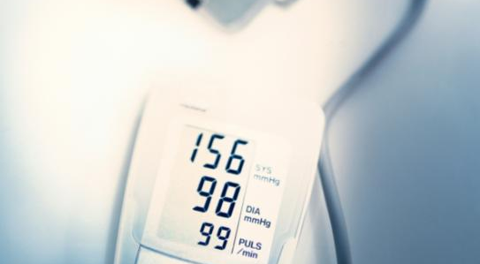
Systolic BP
Value | Score
>90 | 4
76-89 | 3
50-75 | 2
1-49 | 1
0 | 0
Systolic BP 0-4

Slide 25
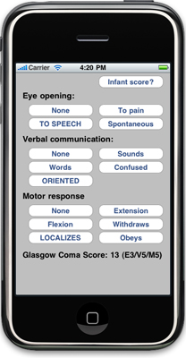
GCS
Value | Score
13-15 | 4
9-12 | 3
6-8 | 2
4-5 | 1
3 | 0
GCS 0-4

Slide 26
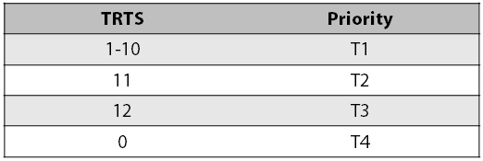
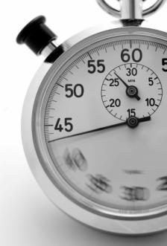
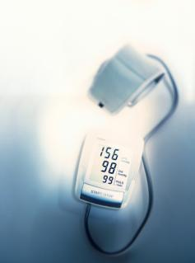
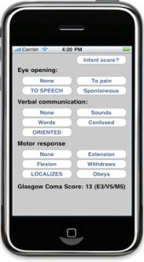

TRTS →Triage priority
+
+
=
Triage sort refines the triage priority
with a relevant anatomical description
Notes:
This slide is animated: the table is visible when you first show the slide and then you should click to get the stopwatch on the left to appear – the remainder of the appearances are animated and require no intervention from you.

Slide 27
Triage Labelling
Highly visible.
Dynamic
Easily secured.

Slide 28
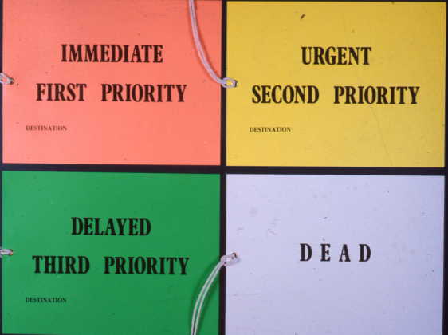
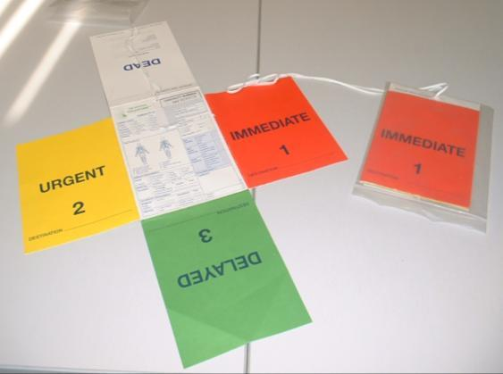
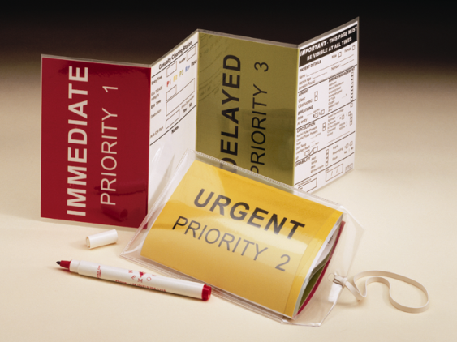
Triage Labelling
Notes:
Indicates that triage has been done
Indicates the current triage priority

Slide 29
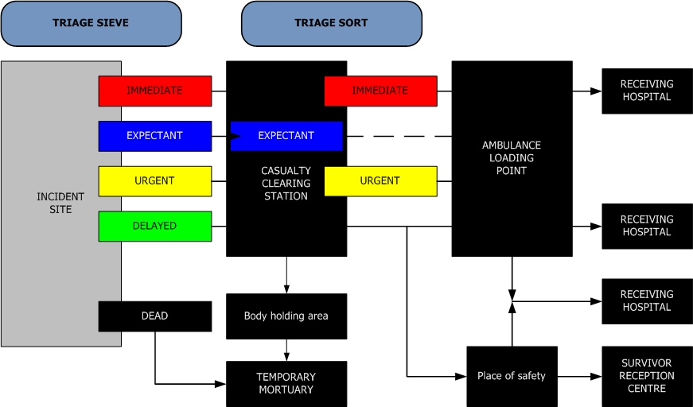
Triage and Evacuation
CCS
© ALSG, 2012
Notes:
This slide shows a schematic triage and evacuation map is shown here
Historically
First Triage decision is likely to be made at the place where the casualty is found
Subsequent decisions at the scene are taken at the CCS
In this scheme it is envisaged that triage on the scene will be carried out predominantly by ambulance personnel while at the casualty clearing station would be carried out by medical staff.
Some patients and particularly the minor injured may move directly from the secondary triage stage via the evacuation area to a hospital without receiving any specific treatment at the scene.

Slide 30
Triage – Implications for ICU
Evaluation of Severity of Injuries.
Liaison with Hospital Control Centre
Develop Plan.
Potential Critical Care admissions need to be evaluated in context of those patients already in the unit
Re-evaluate patients on admission.

Slide 31

Any Questions?

Slide 32
Summary - Triage
Triage Sieve (quickly assigns priorities)
  At the scene
  Dynamic
Triage Sort (refines the priorities)
  More detailed
  At the Casualty Clearing Station
  Dynamic – patient’s status may change

