Slide 1
Find out more
www.odt.nhs.uk

Slide 2
CTtL Promotional Video https://youtu.be/C2PCCwuEI0o

Slide 3
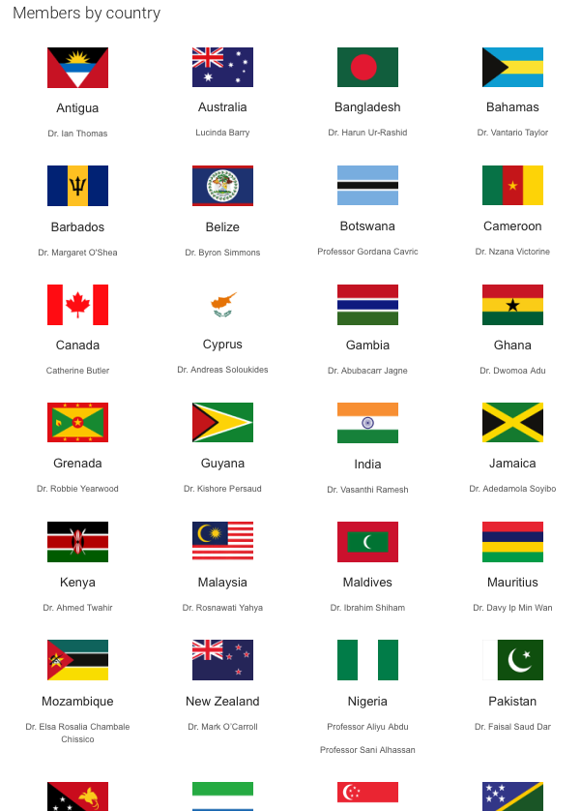
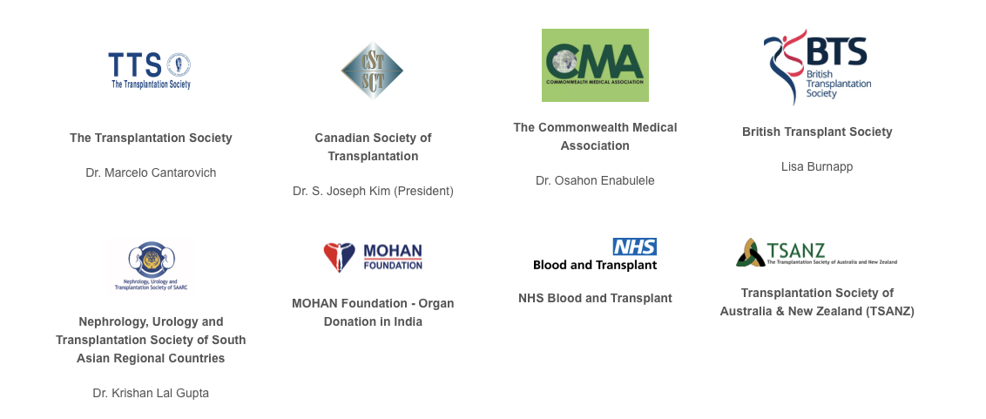
Background – our current progress
Structure of the Tribute to Life Project
Project Board
UK Advisory Panel
International Advisory Panel
41 of 54 Commonwealth nations represented (98.5% of the Commonwealth Population)
6 Regional Coordinators
12 Supporting Organisations
Webpage
www.odt.nhs.uk

Slide 4
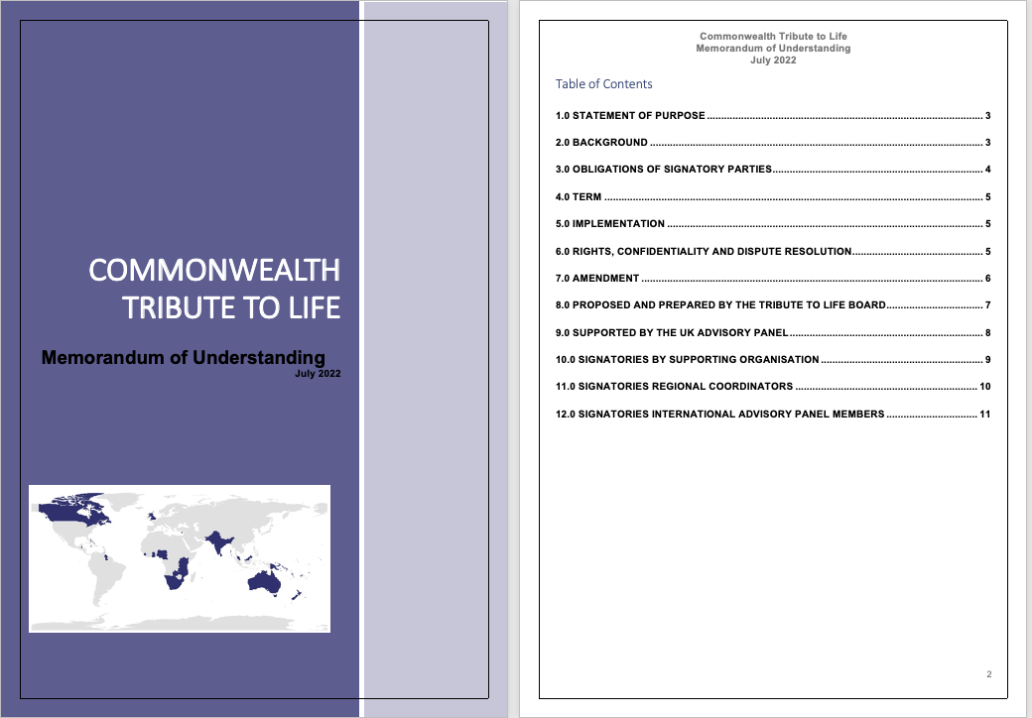
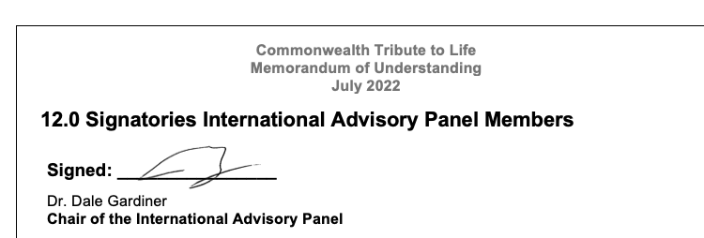
Memorandum of Understanding
Statement of Purpose in MOU
Through the sharing of knowledge and expertise we will increase ethical organ and tissue donation and transplantation, regardless of transplant infra-structure, for the benefit of all Commonwealth citizens.
Signatures received from 34 of 41 Commonwealth representatives

Slide 5
Benefits UK
Leverage the transformational value of sport and the Commonwealth Games as a catalyst for improving health and leading social change.
Expand and deepen efforts to encourage organ donation in diverse UK communities.
Recognise Birmingham City Council's contribution to organ donation and Birmingham’s place as one of the world’s biggest transplant centres.
Showcase the UK as world leading in addressing the issues of health care inequality in organ and tissue donation and transplantation.

Slide 6
Benefits Commonwealth
Connect a community of donation and transplantation healthcare experts.
Expand on existing successful programmes.
Share guidelines, protocols, teaching materials, mentorship and training.
Support progress in increasing organ transplantation.
Provide an opportunity to showcase innovation in organ donation.
Protect vulnerable Commonwealth citizens against illegal and unethical transplantation.
Save and transform the lives of patients in need of transplantation.

Slide 7
Key dates and events
Series of Commonwealth wide webinars
Launch
Event
14 March 2022
Inaugural Ceremony
22 July 2022
Local / regional organised activities across the Commonwealth
Formal Project Launch Commonwealth Day
VIP Event
Hybrid Event, streamed
Grand Station Wolverhampton
Commonwealth Day becomes
an Annual Project Event
Official MOU Start Date
Week before Games
VIP Event
Hybrid Event, streamed
Edgbaston Cricket Ground
High profile supporters / champions
Physical presence around the Games

Slide 8
March to July 2022 – series of weekly webinars
Donation
Transplantation
Promotion
Tissues
Changing donation culture
Diagnosing Death
Role of donation nurses
Opt Out Legislation
Preventing unethical donation
Education
Donation physicians / clinical leads
Starting from zero
Living liver transplant
Living kidney transplant
Immunology
Transplant registries
National Campaigns
Regional Campaigns
Honouring deceased donors
Community engagement
Social media
Transplant Sport
Corneal
Skin banking

Slide 9
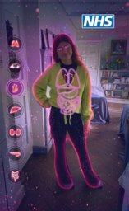
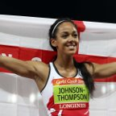
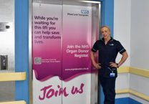
Proposed marketing activation
Local – Birmingham & West Midlands
Strengthening community ties
Local Organ Donation Committees
Birmingham Community Engagement Leads
UK
Making organ donation engaging & accessible across the four nations
PR photo launch
Celebrity athlete advocates
Commonwealth
Maximising social media support
United social media approach to drive advocacy and talkability
Local PR
Event opportunities
Schools engagement
Community Investment Scheme partnering with Commonwealth nations
Social toolkit / video

