Slide 1

Nutrition and Chronic Liver Disease in the Critical Care setting
Nicole Rainford
Senior Specialist Hepatology Dietitian

Slide 2
What we will be covering today
Malnutrition in liver disease
Sarcopenia and weight loss
Feeding in the critical care
Nutritional requirements in liver disease
Pancreatitis and malabsorption
NJ feeding and PN
Notes:
In the interests of time, I have focused on chronic liver disease as these patients are often the most concerning from a nutritional perspective

Slide 3
Malnutrition in chronic liver disease
Malnutrition is one of the most common complications of liver disease is prevalent in even early stages – up to 46% of Childs Pugh A increasing to 95% of Childs Pugh C. (Cheung et al, 2012)
Malnutrition leads to increased complications – ascites, hepatorenal syndrome, HE, variceal bleeding and infections (Thandassery and Mantano-Loza, 2016)
Peng et al (2007) found significant protein depletion in 51% of population but there were marked differences between men and women 28% for women and 63% of men
Sarcopenia is present regardless of BMI – Increasing rates of sarcopenic obesity (Montano-Loza 2014)
Ascites is much more common in protein depleted patients 47% vs 22%
Malnutrition is an independent risk factor for mortality - length of survival 65% of that of non-sarcopenic patients
Hypermetabolism seen in up to 38% of STABLE cirrhotics and REE up to 30% higher than expected (Muller, 1999)
Notes:
Yet sarcopenia is often overlooked and its influence is minimsed Therefore patients attending critical care are more likely to be of the malnourished cohort
Survial of 19 months compared to 35 months

Slide 4
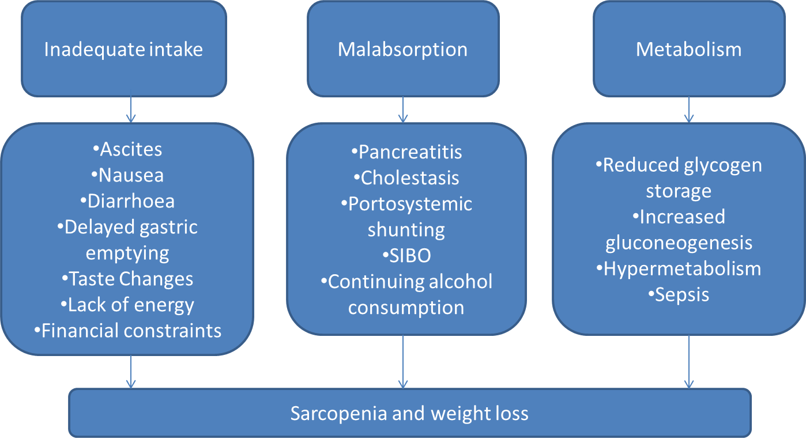
Sarcopenia and weight loss is multifactorial
Adapted from Kim and Yang (2015)
Notes:
So we know that liver patients are likely malnourished before they come to the critical care unit. So what does the critical care literature say we should do about it

Slide 5
The liver disease patient on ITU
Patients with end stage liver disease requiring critical care admission with have limited physiological reserve
Some of the main causes for admission to ITU include hepatic encephalopathy, GI bleeding, sepsis/infection and respiratory failure
Increasing numbers of organ support reduces likelihood of survival – though most will have multiple organ failures
ITU stays can be long sometimes in the order of months so need to consider longer term consequences

Slide 6
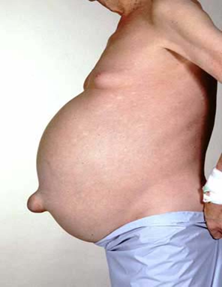
Assessment of liver patient
Weight is difficult to assess due to fluid retention
Volume of ascites can exceed 20kg
Mid Arm Circumfrence can help assess and monitor weight (though oedema is not uncommon)

Slide 7
Feeding in critical care
Barr et al (2004) – Meeting nutritional requirements associated with lower mortality and increased ventilator free days
Khalid et al (2010) – Early enteral nutrition in haemodynamically unstable patients showed reduced mortality with the sickest patients conferring the largest benefits
ESPEN – Critically ill patients with a chronic catabolic disease should be fed to meet full requirements, supplementary PN should be used if needed
Much focus on early nutrition and its influence on mortality and LOS in ITU and hospital
One of the major drawbacks of much nutritional research in the critical care is that it treats all patients the same and does not tend to stratify in terms of nutritional risk.
Notes:
Khalid 1174 patients non surgical patients who received mechanical ventilation enteral nutrition started within 48 hs vs later feeding enteral nutrition increased blood flow to the gut and reduced bacterial translocation

Slide 8
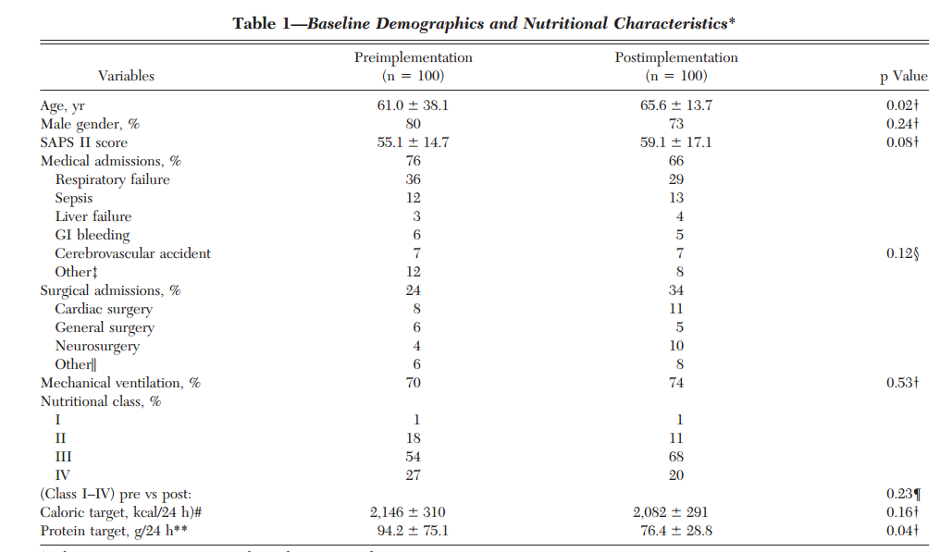
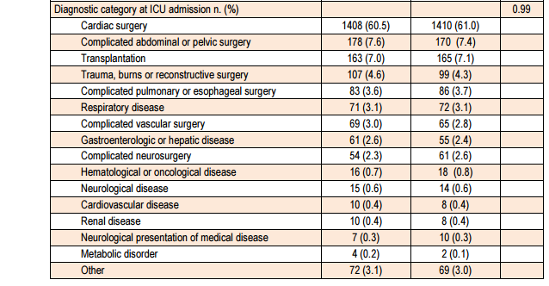
Hepatology patients make up a tiny proportion of patients examined
EPaNIC trial
Notes:
EPaNIC no benefit and evidence of harm from early PN, covered 7 centres, disproportionate number of cardiac surgery patients

Slide 9
Or are excluded altogether
TICACOS trial:
‘ The main exclusion criteria were requirement for inspired oxygen content (FiO2) greater than 0.6, air leaks through chest drains, inhaled nitric oxide therapy and continuous renal replacement therapy (CRRT), and pregnancy. In addition, patients suffering from significant head trauma (GCS\8), severe liver disease (Child–Pugh score C), or after open-heart surgery were also excluded because the length of stay is frequently related to the underlying condition.’
Notes:
So if the critical care literature does not tell up what we should do, where next?

Slide 10
Calculating nutritional requirements in liver
Aim to start feeding on admission and meet requirements within 48 hours – slower if high refeeding risk
Ensuring Pabrinex is given before feeding commenced
Penn State or 25kcal/kg in intubated and ventilated patients taking into account propofol and IV glucose calories
More aggressive nutritional support when patient no longer on full ventilation
Aim minimum 1.2g-1.5g protein/kg
If on CRRT 1.7g/kg increasing unto 2.5g/kg if possible according to tolerance - Sheinkenstal et al found that positive nitrogen balance was only achieved at protein intakes above 2g/kg, for every 1g increase in protein there was a 21% increase in survival
Consideration of Additrace for zinc deficiency and Vitamin D supplementation
Notes:
Avoid overfeeding in the sickest, assessment of nutritional status is difficult in liver patients due to fluid overload.
Testing micronutrients unlikely to be helpful in critical illness due to stress response

Slide 11
Indirect calorimetry
Measures resting energy expenditure
Possibly very helpful in liver diease
Patient 18 years male, liver failure due to Wilsons, ventilated
EER was 1832kcal – 35kcal/kg vs standard ITU requirements which would be around 1250.

Slide 12
NJ tube insertion and PN
NJ tube insertion should be considered in those with high residual gastric volumes despite pro-kinetics, persistent vomiting, pancreatitis
Bedside insertion of NJ tubes reduce patient waiting times for tube insertion
PN should be considered in those where enteral feeding cannot be established or in those who can only tolerate small volumes of enteral nutrition
Liver failure is not an automatic contraindication for PN
Can be especially helpful in particularly malnourished patients

Slide 13
Pancreatitis and Cholestasis
Pancreatitis is a common finding in alcohol related liver disease and should be considered in all those presenting with alcohol related liver disease
In patients with diarrhoea or signs of fat malabsorption or a calcified pancreas pancreatic insufficiency should be considered
Semi-elemental formulas should be used with pancreatic enzymes
Pancrex V 1g every 2-4 hours or Creon 25,000 unit tablets every 4 hours – be aware of volume of sodium bicarbonate
Bilirubin > 300 consider lower fat feeds – these tend to be semi-elemental
If eating fat to tolerance

Slide 14
Summary of recommendations
Aim to start enteral feeding within 24-48 hours or admission
Use of feeding protocols and pro-kinetics
Ensure refeeding medications are given in those at risk
Low threshold for NJ insertion/PN
Trial of pancreatic enzymes and semi-elemental formulas in cases of suspected malabsorption
Monitor, monitor, monitor - patients are evolving continuously

Slide 15
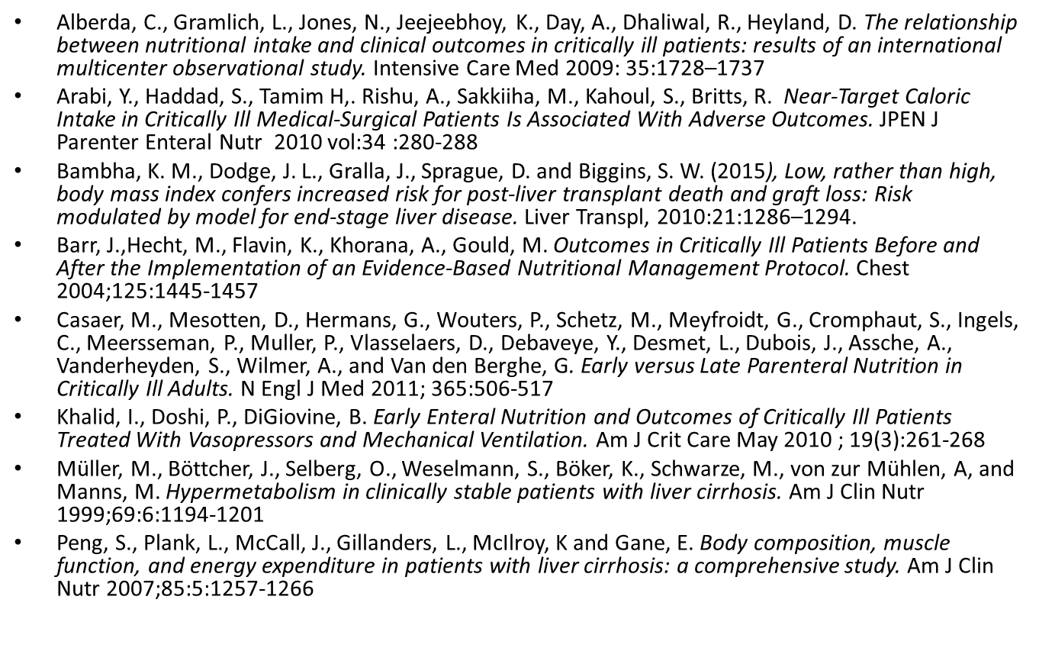
References

Slide 16
References
Cheung, K., Lee, S., Raman, M. Prevalence and Mechanisms of Malnutrition in Patients With Advanced Liver Disease, and Nutrition Management. Clinical gastroenterology and hepatology; 2012;10:117–125
Kim, H., Yang, J. Sarcopenia in the prognosis of cirrhosis: Going beyond the MELD score. World Journal of Gastroenterology; 201521(25): 7637–7647.
Montano-Loza, A. Clinical relevance of sarcopenia in patients with cirrhosis. World Journal of Gastroenterology; 2014 Jul 7; 20(25): 8061–8071.
Thandassery, R.B. & Montano-Loza, A.J. Curr Treat Options Gastro; 2016;14: 257-273

Slide 17
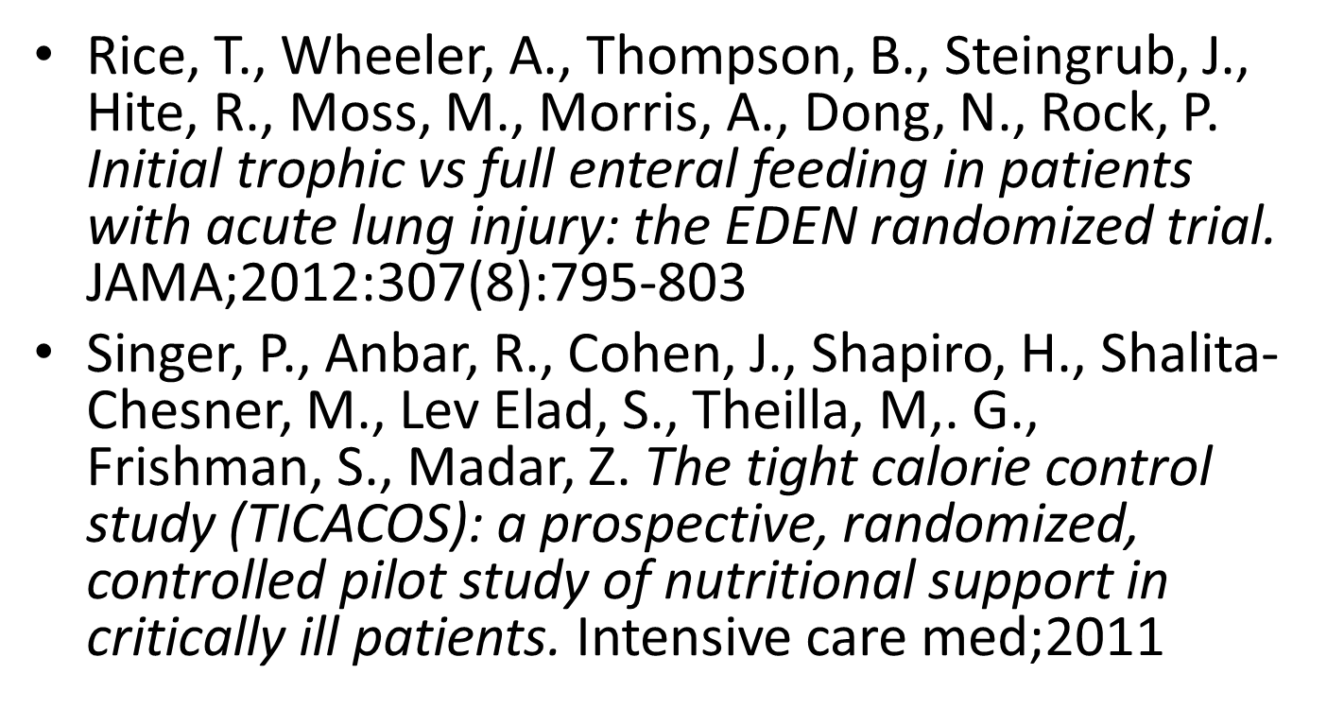
References

