Slide 1

SUSTAIN-ING: Preliminary Findings
A study to understand the impact that Professional Nurse Advocates (PNAs) undertaking quality improvement work have on patient outcomes and patient experience.
Liz Lees-Deutsch and Dr Laura Wilde
Professor for Nursing Practice and Research Fellow
Centre for Care Excellence and Centre for Healthcare Communities
University Hospitals Coventry and Warwickshire NHS Trust
Coventry University
Lead contact: Liz.lees-deutsch@nhs.net
X (Twitter): @LizzieDeutsch @laurawilde24

Slide 2



The Study Team
Prof Liz Lees-Deutsch
Dr Laura Wilde
Prof Rosie Kneafsey

Slide 3
SUSTAIN 2023 – Key Messages
Prior to the PNA Programme, the delivery of restorative support and clinical supervision was not well developed in nursing, despite some pockets of good practice.
Regional and Site Lead PNAs need adequate time to drive the strategy, they are juggling ‘other’ priorities which creates challenges for implementation at site level.
Disparity in the assessment strategy for PNAs across the HEIs and work-based learning in current NHS pressures, is hard to achieve and accommodate.
Adequate ‘time’ release of nurses, and access to ‘office space’ is needed for PNAs to facilitate RCS and, is critical to sustain the delivery of the programme
The creation of a large-scale PNA movement through the programme with the support for nurses is the transformative element of empowerment and satisfaction at work.
Nurses feel restorative clinical supervision is making a difference, but we do need to understand more about how RCS is experienced and develops.
More work is needed to understand, develop and promote all elements of the A-EQUIP model in practice, particularly QI projects.
3,315 downloads: PURE
Notes:
Early days!
An embedded approach
Reducing stigma or hyper arousal and over extended states of functioning.
Identifying and Supporting PNAs
Plenty of Opportunity for future research – particularly in relation to how Restorative Clinical Supervision develops and how this then relates to A-EQUIP

Slide 4



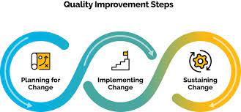
Quality Improvement

Slide 5

2024 Research (so far)
©
Gap – in development of quality improvement work
In 2024, SUSTAIN-ING:
A study to understand the impact of Professional Nurse Advocates (PNAs) undertaking quality improvement work, on patient outcomes and patient experience was commissioned by NHSE.

Slide 6
Study Workstreams
Rapid Review
Workshop
SURVEY
CASE STUDIES
Expert PNA Group – informing questions, interpretations throughout

Slide 7

Scoping Review

Slide 8
PNA Review inclusion/exclusion
Populations
Interventions
Comparison
Outcomes
Context
"Professional Nurse Advocate" OR international Nurse OR Midwife AND Nurses
Quality Improvements in clinical practice through the AEQUIP model of delivery
Samples, similarities, and differences between organisations before PNAs
Leading quality improvements in NHS care by Nurses
NHS settings only (e.g. Acute Hospitals, Mental Health Trusts, Primary Care)

Slide 9
Identification of studies via databases and registers
Records identified from:
Databases (n = 108)
  Medline = 15
  CINAHL = 76
  Emcare = 17
Records removed before screening:
Duplicate records removed
(n = 26)
Identification
PRISMA flow diagram for PNA search
(July 2024)
Records screened
(n = 82)
Records excluded**
(n = 73)
Reports sought for retrieval
(n = 9)
Reports not retrieved
(n = 0)
Screening
Reports assessed for eligibility
(n = 9)
Reports excluded
(n = 9)
Studies included in review
(n = 0)
Included

Slide 10
PNA Review findings
Of the 9 full texts reviewed none met the eligibility criteria for inclusion.
Papers were:
  Descriptions of the PNA role (Smythe et al., 2023; Pearce, 2023a, Pearce, 2023b)
  Descriptions of the role of RCS in the PNA model (Scanlan & Hart, 2024; Hart & Scanlan, 2024)
  A reflection on being a PNA (Brookes, 2022)
  A study to address the lack of professional development time with monthly workshops (Francis et al., 2024)
  A study implementing clinical supervision by PMAs and PNAs to understand the effect of the supervision on wellbeing (Ash & Pollock, 2023)

Slide 11
Identification of studies via databases and registers
Records identified from:
Databases (n = 157)
  Medline = 13
  CINAHL = 108
  Emcare = 36
Records removed before screening:
Duplicate records removed (n = 39)
Identification
PRISMA flow diagram for PMA search
(July 2024)
Records screened
(n = 118)
Records excluded**
(n = 99)
Reports sought for retrieval
(n = 19)
Reports not retrieved
(n = 0)
Screening
Reports assessed for eligibility
(n = 19)
Reports excluded
(n = 17)
Studies included in review
(n = 2)
Included

Slide 12
National Evaluation
PMA Review findings
19 full texts reviewed
Two studies were eligible for inclusion; Horler (2020) and Sterry (2019).
Horler (2020) implemented a quality improvement project within the student PMA NHS Trust to increase the home birth rate.
Sterry (2019) introduced the A-EQUIP model and PMAs role as a quality improvement initiative to support change in practice.

Slide 13
Expert PNA Group
(Reference group)
Understanding our assumptions (short survey)
Maturity Matrix (for the compendium)
Definition of Quality Improvement (in progress)

Slide 14
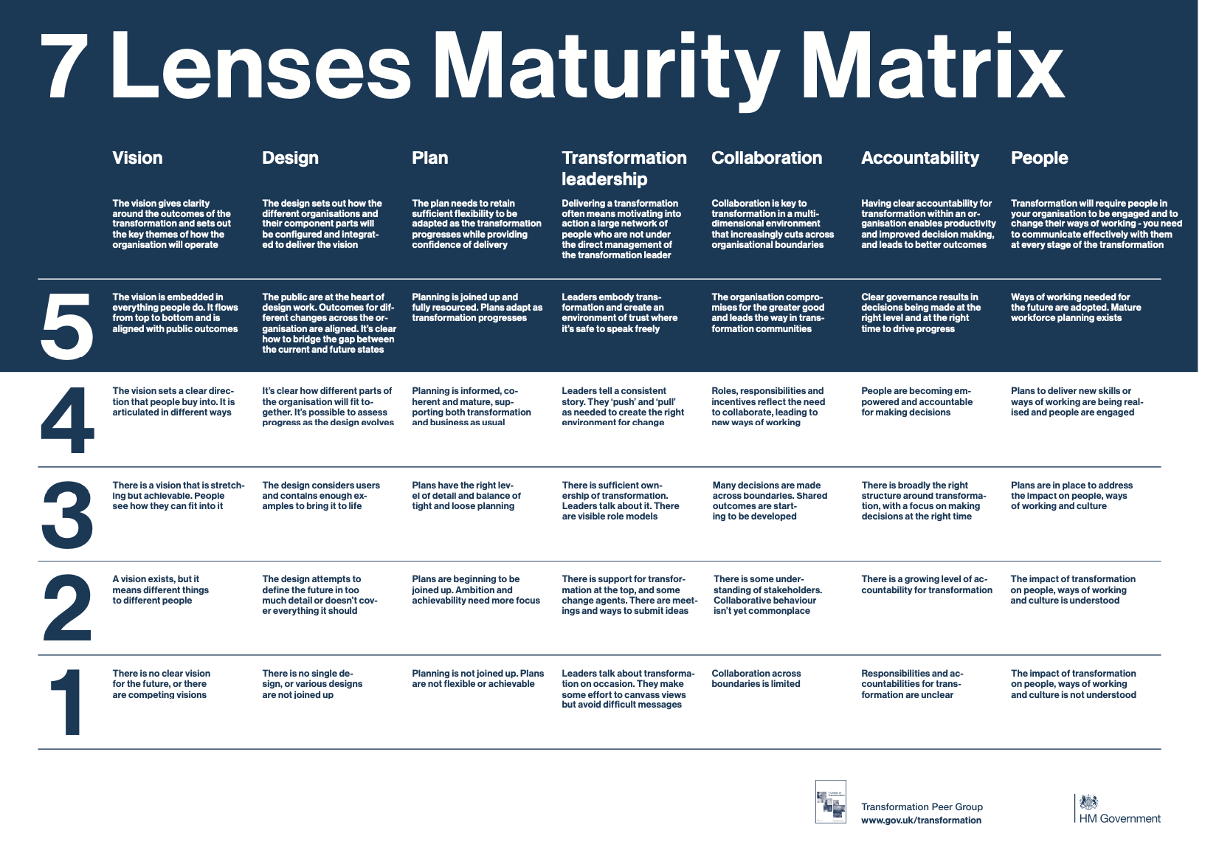

Slide 15
Case Studies – where we are at
7 case study interviews completed
406 minutes
(6.5+ hours)
334 pages
70,000+ words
Analysis in progress
Notes:
Details are anonymous at the moment
Analysis planned-
constant comparison

Slide 16
Case Studies –
Preliminary thoughts on findings
Team work vs silo QI projects
Varied ways of identifying QI projects
QI methods
Restorative-focused QI
Patient outcome focus varied
Education and the PNA course
Sustainability of QI work varied
Reach and dissemination of QI work varied
Notes:
Varied understanding of approaches and methods
Learning and development
Variety of scale and reach of projects
Measurement and demonstrating the impact is really challenging
Teamwork seems to be really important and collaborating with others, though this is varied and not consistent with some siloed working and feelings of isolation - support is varied
Restorative conversations are invaluable. Relly make a difference to people
Projects are really bottom up and come from patients (through feedback) and nurses (conversations)
How QI projects are reported and shared varies and seems like it would be helpful for more of this – we are in the right place

Slide 17
Work currently in progress
Principles of QI work
Survey
Compendium of Case Studies

Slide 18
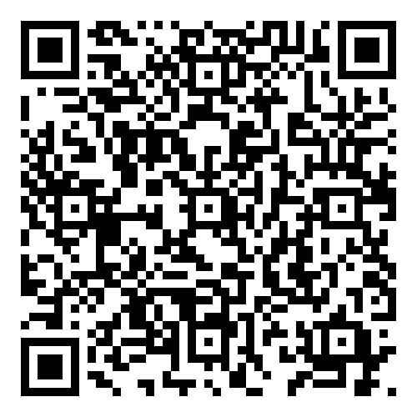
Dissemination Impact
Complete
Study
Conference
Invited Talks
Report Full Study
Article
Podcast
Lees-Deutsch L, Palmer S, Adegboye A. Bayes, N. Chauntry, A. Kneafsey, R, (2023) National Evaluation Report of the Professional Nurse Advocate Programme: Mixed Methods Study. ISBN - 978-1-84600-1154
https://pureportal.coventry.ac.uk/files/70132294/REPORT_Final_June_2023.pdf
4,015

Slide 19
Questions Welcomed
Liz Lees-Deutsch and Dr Laura Wilde
Professor for Nursing Practice and Research Fellow
Centre for Care Excellence and Centre for Healthcare Communities
University Hospitals Coventry and Warwickshire NHS Trust
Coventry University
Lead contact: Liz.lees-deutsch@nhs.net
X (Twitter): @LizzieDeutsch @laurawilde24

