Slide 1

Professional Nurse Advocates in the
North West
December 2024
Notes:
Standard title slide

Slide 2
Introduction - Who am I?
Victoria Hughes – victoria.hughes40@nhs.net
North West Regional PNA Advisor
Commenced Sept 2023
Organisational PNA Lead – Alder Hey 2021-2023
PNA training April 2021

Slide 3
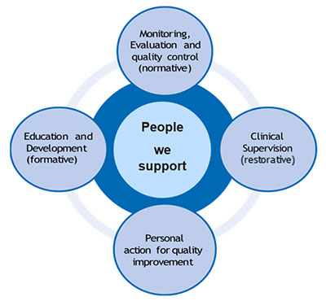
Background
The Professional Nurse Advocate (PNA) programme delivers training and restorative supervision for colleagues right across England. The programme launched in March 2021, towards the end of the third wave of COVID-19. This was the start of a critical point of recovery: for patients, for services and for our workforce. (NHSE 2023)
PNA’s are taught to embed the Advocating and Educating for Quality Improvement (A-EQUIP) model into nursing clinical practice
The vision of Ruth May (Chief Nursing Officer) who has implemented the PNA role:-
It has been identified there is a need for nurses to be equipped to understand the demands of their role and how colleagues may be feeling, developing skills of leadership, quality improvement and to embed robust Restorative Clinical Supervision (RCS) within healthcare
The below video has been created to show the PNA role and structures to support
https://youtu.be/KsfBu7xeRgE
Notes:
The Professional Nurse Advocate (PNA) role was implemented in March 2021 and followed the Professional Midwifery Advocate (PMA) role, which had been introduced in 2017. The purpose of the PNA role was to create an opportunity for nurses to be trained to support nursing colleagues, during and after the covid pandemic.
This support is via the use of the A-EQUIP model, also used by PMA’s, which enables clinical supervision, education and development, quality improvement, and monitoring and audit, as key tools to support the well-being and career progression of the nursing workforce.

Slide 4
Impact of PNA – Evaluation
In February 2022, NHSE sought an evaluation of the PNA programme and a research team from Coventry University was commissioned to undertake this work. The evaluation aim was to explore the impact of the Professional Nurse Advocates (PNA) programme on PNAs and wider team, with recommendations for improvements.
HOW -
An electronic survey was distributed by NHS England between August and December 2022, via email to three constituent groups: Nurses who received RCS (known as RCS Nurses); PNAs; and Trust PNA Leads. There were 302 responses to the survey (RCS Nurses n=73, PNAs n=214, Trust Leads n=15).
Case Studies were conducted with eight sites, spanning Healthcare and HEI settings across England to provide in-depth, contextually based information regarding the implementation of the professional nurse advocate programme
Interview data were collected from 63 individuals, with 59 individual interviews and 4, two-person interviews. This included Regional PNA leads (6), Trust PNA leads (13), PNAs (32) and RCS Nurses (7) and HEI Leads (5).
COMMENTS-
Participating in RCS was described as a positive and constructive experience by many RCS nurses which had boosted their self-confidence, leaving them restored and reinvigorated…RCS and career conversations are enabling nurses, who might otherwise leave the profession, to stay.
general appreciation was reflected that the PNA programme has opened opportunities for nurses at any stage of their career to engage in further study and to combine this with experience, which served to make nurses feel valued and empowered in their roles

Slide 5
Evaluation
In February 2022, NHSE sought an evaluation of the PNA programme, with the aim to explore the impact of the Professional Nurse Advocates (PNA) programme on PNAs and wider teams, with recommendations for improvements.
Prior to the PNA Programme, the delivery of restorative support and clinical supervision for nurses was not well
developed, despite some pockets of good practice. Learning from the areas good practice developed through the programme must be adopted across England.
2. Regional and site Lead PNAs require more time to drive the PNA Programme strategy, juggling ‘many other’ priorities which create challenges for implementation at site level. There is much learning that could be shared across each wave of roll out to avoid replication in the development of work and the energy needed to deliver the programme.
3. Disparity in the PNA Programme assessment strategy across HEIs and, the requirement for work-based learning in current NHS pressures, requires an agreement for parity for of assessments at Level 7.
4. Adequate ‘time’ release of nurses, and access to ‘office space’ [privacy] is needed for PNAs to facilitate RCS and career conversations, these elements at site level are critical to sustain the programme delivery.
5. More work is needed to develop and promote all elements of the A-EQUIP model in practice, particularly quantifiable improvements in patient care arising from QI work.
6. Further understanding regarding if/how progress is enabled through the RCS model, is needed. This we suggest is an important area for further research to clearly articulate the benefits to the individuals and teams, over time.
Notes:
Rcn standards
You’re needed to help work towards the others

Slide 6
Implementation
Training
17 universities providing PNA training nationwide meeting these requirements:-
Learners must hold an active NMC registration.
Learners must be employed in a registered nursing role.
Learners must practice within a health care setting that provides NHS or NHS commissioned services.
Learners must provide evidence of holding a level 6 certificate in education (ie, BSc Hons in Adult Nursing) or above
Those without a level 6 certificate in education must provide evidence of prior learning; where approved, education institutes must support learners to attain the skills and knowledge to study at level 7 (or equivalent).
Usually 10 weeks in length
Variety of assessment methods
RCN PNA education standards https://www.rcn.org.uk/Professional-Development/publications/professional-nurse-advocate-standards-uk-pub-010-854
Practice
From 1 April 2022, providers of nursing services have been encouraged, via the NHS Standard Contract Service Development and Improvement Plan (SDIP), to implement the PNA role within their organisations.
one PNA per clinical team/ward will be needed, and to achieve this, nursing providers should commit to training at least 1 in 20 registered nurses for the PNA role by 2025.
Organisation’s chief nurse to
- identify a senior registered nurse who is responsible for the oversight and implementation of PNAs
- Create a live register of the PNAs employed in the organisation: Establish a PNA community of practice.
- Ensure completion of the provider workforce return (PWR) reflecting PNA activity
Notes:
Standardisation but flexibility

Slide 7
Regional PNA Lead Roles & Responsibilities
Connect with all NHS organisations to ensure the effective implementation of the PNA role into practice.
Support the regional and local co-ordination of nationally-funded PNA training places.
Establish local, system and regional PNA networks.
Ensure governance processes are in place to monitor the implementation of the PNA role across their region and link with the national team.
Produce a monthly report collating the local and regional PNA data as well as any associated action/resolution undertaken, and share this with the national NHS England PNA team.
NHSE implementation Guidance -https://www.england.nhs.uk/publication/professional-nurse-advocate-a-equip-model-a-model-of-clinical-supervision-for-nurses/
Notes:
My role is small and supportive

Slide 8
PNA Roles & Responsibilities
Clinical support:
advocate for patients, reinforcing that every nurse’s role is to support patients and their families
in creating care plans collaboratively with patients and/or families in a challenging situation, such as supporting a patient to make safe choices based on the best available evidence, using the restorative function of the A-EQUIP model
demonstrate inspirational, motivational and visible leadership in the workplace
support change in clinical area(s)
role model promoting psychological safety and situational awareness in own practice.
Wellbeing support:
discuss any professional issues, including clinical incidents, team dynamics, stress, burnout, instances of bullying, career progression, interviews and quality initiatives, as well as personal issues
following a traumatic or stressful event, allow (or create) the opportunity for reflection to reduce stress and enable learning, limit compassion fatigue and improve confidence
portray an understanding of personal and professional resilience, developing this attitude in others.
Notes:
? Link to a-equip model
You are the ones who may the impact

Slide 9
PNA Roles & Responsibilities
Learning support:
to develop a nurse’s ideas and actions for quality improvement and service development
hold reflective discussions about revalidation and career development, preparation for appraisal
coach staff through reflection on incidents they may have experienced, with a focus on the system and processes.
Promoting the PNA role:
support aspirant PNAs and PNAs in training, including by providing support and supervision
collate data on the effectiveness of restorative clinical supervision (RCS) for staff, and the benefit of the PNA role.
Scheduling meetings with healthcare staff:
arrange any individual meetings at a mutually convenient time
identify a private and confidential meeting place
mutually agree how long the RCS/meeting will last
agree ground rules for the session and document these
retain and confidentially store any notes taken at the meeting.
Personal, professional development:
participate in and lead on quality improvement programmes
engage in booster sessions following PNA training.
NHSE implementation Guidance -https://www.england.nhs.uk/publication/professional-nurse-advocate-a-equip-model-a-model-of-clinical-supervision-for-nurses/

Slide 10
Reporting Activity - PWR
Total number of registered nursing staff with a PNA qualification (headcount)
Total number of restorative supervision sessions conducted by a PNA (total in month)
Total number of individuals receiving restorative supervision session in month
Total number of career conversations delivered by a PNA (total in month)
Total number of individuals receiving a career conversation in month
Total number of improvement projects/programmes supported by PNAs (rolling total)
Notes:
Showcase what you do –pwr
Why these questions?

Slide 11


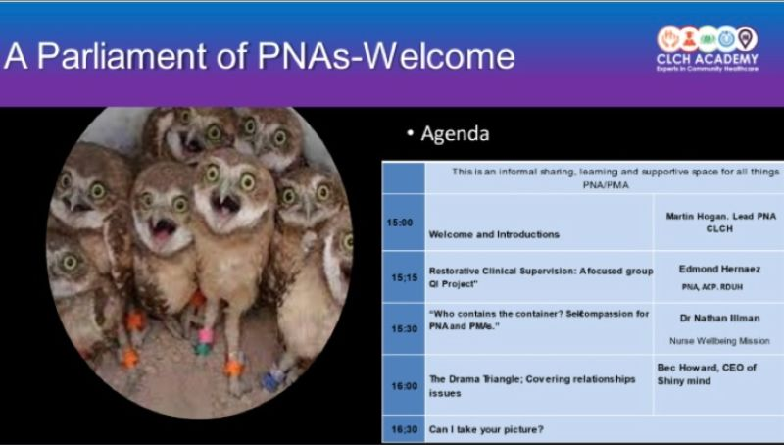



Support & Development
Notes:
Link to existing pnas and services – use the support, to allow you to support others

Slide 12
Thank you!
Notes:
Showcase what you do -pwr

