Slide 1
Guidelines for Implementation of PNAs in Critical Care
Development and implications
Dr Julie Highfield
Consultant Clinical Psychologist

Slide 2
Project analysis slide 2
Process of
Development
PINC UK SURVEY
PNA Stakeholder group
PNA Guideline
PNA COP Survey
Consultation Process
PNA COP Discussion
Endorsement process

Slide 3

Project analysis slide 3
Key Intentions
of document
MARKET ANALYSIS
ECOLOGICAL ANALYSIS
To support PNAs in practice
.
To focus on PNA strengths
To enable PNAs to set limits and boundaries

Slide 4
Development and Consultation
PINC UK Survey
FEB 24 COP survey
APRIL 24 COP discussion
May- July COP stakeholder group drafting
July- AUG consultation
SEPT 24 endorsement

Slide 5
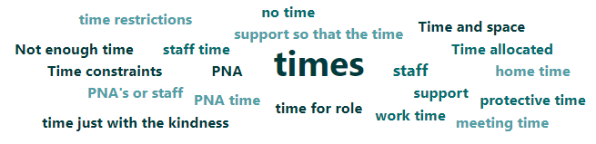
PNA Survey
Role: creating safe spaces to support staff and support QI
50% felt able to deliver
62% given protected time
58% receive RCS themselves

Slide 6
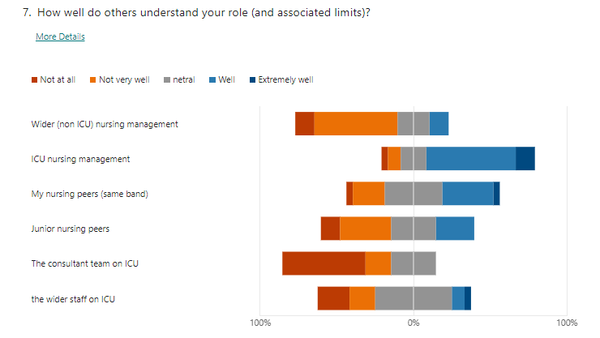

Slide 7
PINC UK Survey
17 ICU Psychologists gave their thoughts on working alongside PNAs:
Need for co-working and psychologists to support PNAs
Concerned for welfare of PNAs being asked to provide psychological care and debriefs
Not enough protected time
Struggle for the role to fit into ICU setting & need for flexibility

Slide 8
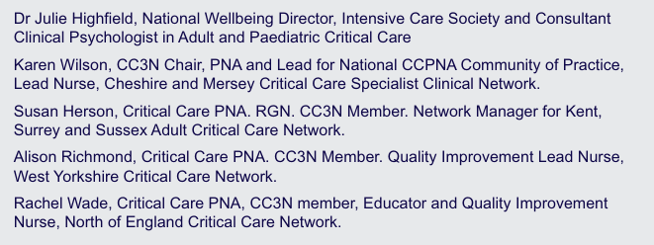
PNA Stakeholder Group

Slide 9
Consultation groups
PNA COP
CC3N
Circulated to all neonatal PNAs and PCCU PNAs
PINC UK & ACP UK
38 individual responses received plus whole organisation collated responses

Slide 10
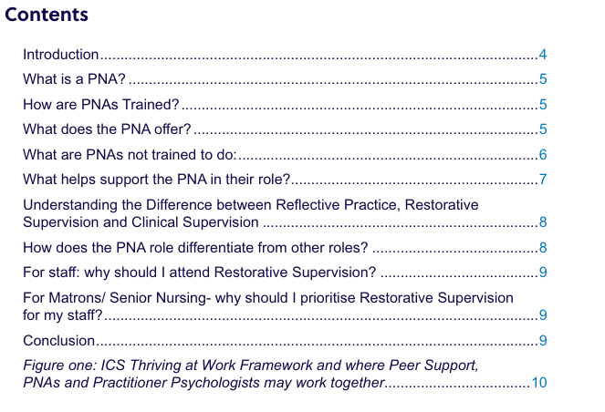
Key elements of document

Slide 11
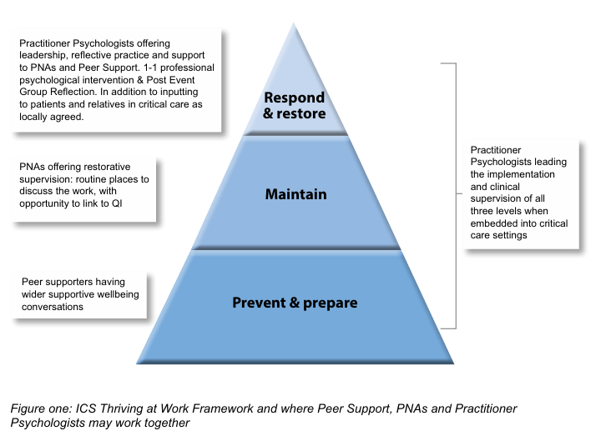

Slide 12
Peer Support
Supportive conversations
RCS
Formalised reflection upon practice

Slide 13
Project analysis slide 6
Implications
for Practice
Focus on restorative clinical supervision.
Places to reflect on practice and offer emotional support.
Being valued and integrated into practice. Proactive, not reactive
Not being pulled into mental health roles
Not running psychological debriefs
Supporting the PNA with protected time, ongoing CPD and supervision.

Slide 14
Project analysis slide 8
Project Analysis
POSITIVE
LIMITATIONS
Overall, well received
Offering a voice to PNAs written by PNAS
Protecting time and embedding practice
Welcomed by Psychological Professions as a way of working together and differentiating practice
Some criticism for focussing on adult ICU PNAs
We did consult with paeds and NICU
Some people wanting a practical “to do” list
Guidelines are not enforced, so variation will continue

Slide 15


Endorsements

Slide 16
Thank you

