Slide 1


THIRST PROJECT
Critical Care GSTT
Jenny Clark
Clinical Lead Speech and Language Therapist / Thirst Project Lead
07548152979
Jenny.Clark1@gstt.nhs.uk
THIRST PROJECT
Critical Care GSTT
Jenny Clark
Clinical Lead Speech and Language Therapist / Thirst Project Lead
07548152979
Jenny.Clark1@gstt.nhs.uk
Notes:
Slide one: Background

Slide 2

GSTT THIRST PROJECT
Notes:
Who am I and what is the project

Slide 3

‘I have never felt so thirsty in all my life!!!’

Slide 4


‘I remember this woman was coming to assess my swallowing and they told me about it. I knew it was a big thing. I thought “I am not coughing, I am NOT coughing”. I needed to pass’
Give me sponge with alcohol on it? I felt sick but it was better than nothing
‘My husband asked me if I would do it all again? I said I would but not the thirst’
‘I have never felt so thirsty in all my life’
I would put an ice cube on my lip and let it melt to avoid choking.
I couldn’t quench my thirst – 14 weeks in hospital – thirsty all the time.’
‘They’re always giving me the sponges. The green ones. I hate the sponges, they’re like brilopads!’
‘I was crying for ice’
‘I was physically unable to access the fluids on the table, I couldn’t reach them’
Thirst was like being in a desert. So distressing.
Can you tell patients why they are thirsty? Explain they are being dried out and why? So you know there’s a reason for it and that the feeling won’t be forever. I didn’t know there were medical reasons why I was thirsty.
‘It's so hard seeing everyone eating and drinking around me, why do you mix the people who can and can't?’
I was started on fluids first then solids but I was still thirsty
My pain meds were making me thirsty so I didn’t want them. The thirst was worse than the pain.
Notes:
Most powerful feedback has been the stories patients tell
Selection of quotes form patients collected during my time talking to patients about thirst across all the work

Slide 5
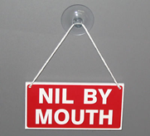
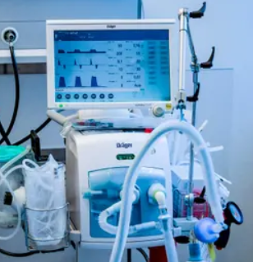
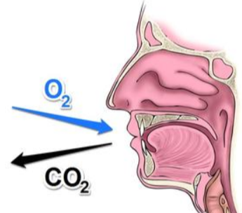

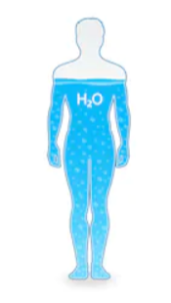
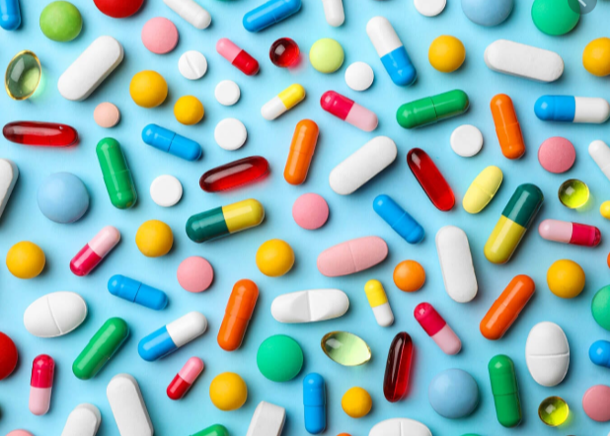
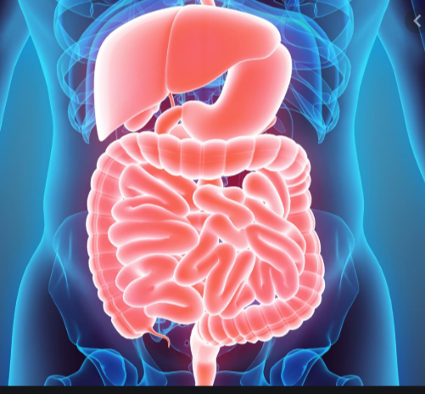
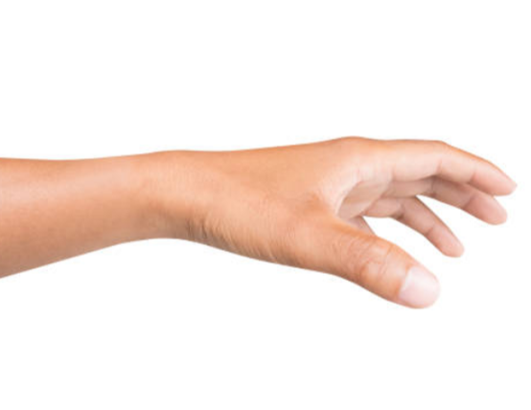
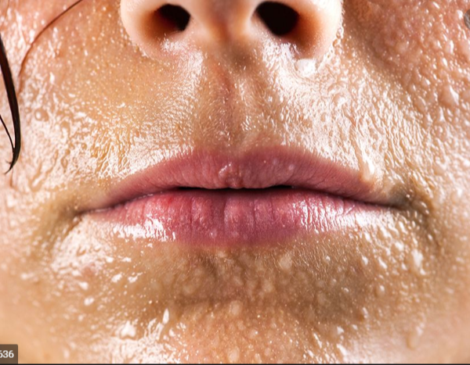
Notes:
Why is thirst so problematic in critical care?
The perfect or imperfect storm of risk factors in the critical care population.
Of course these risk factors exist in other populations but in critical care we frequently seen these risk factors co occurring in our patients driving profound thrist.
Medication - high opioid doses ($50 mg), high furosemide doses (>60 mg), selective serotonin reuptake inhibitors. Anti hypertensives
NBM status
GI diagnosis – leading to issues with malabsorption
Mechanical ventilation
Lung and heart protective negative fluid balances leading to systemic drying
Insensible losses – sweating, diarorrea, vomiting
Inability to physically reach fluids and independently drink due to ICU acquired weakness
Mouth breathing – low oro facial tone/ muscle wasting leading to increased risk of mouth breathing and oral drying

Slide 6
Strengths | Weaknesses
Opportunities | Threats/obstacles
MULTI-PROFESSIONAL & PATIENT THIRST FORUM

Slide 7
Strengths Addressing the issue via quality improvement work Engaged and motivated staff Current oral care practices and oral sponge usage | Weaknesses Lack of consistency on what thirst management is provided Lack of communication around what patients can/cannot have (e.g. ice) Missed drinks rounds due to sleep, rehabilitation sessions, procedures Thirst is not explained to patients or explicitly assessed
Opportunities ‘Wake me for . . ’ or ‘please leave a drink’ stickers’ Medical team to consider sodium if over 155 mmol/L Explain to patients why they are thirsty Assess thirst and talk about it openly Consider humidification if on oxygen Further study and research into thirst Thirst assessment and management plans to be put in place based on patient feedback and evidence base. | Threats/obstacles Fear of safety risks/ aspiration risk Easy access to ice SLT – feedback that more resource needed, presence and help to nursing staff Busy staff already managing numerous symptoms Insatiability of thirst is well reported – difficult to contain symptom/satiate
MULTI-PROFESSIONAL & PATIENT THIRST FORUM

Slide 8
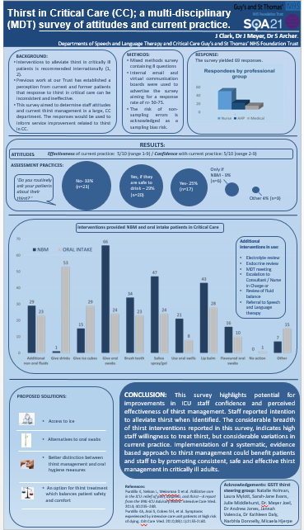
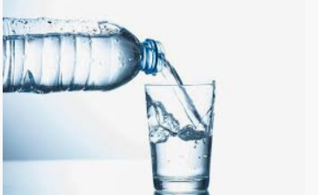
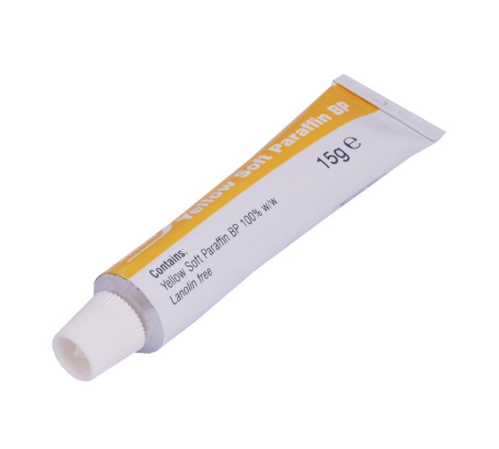
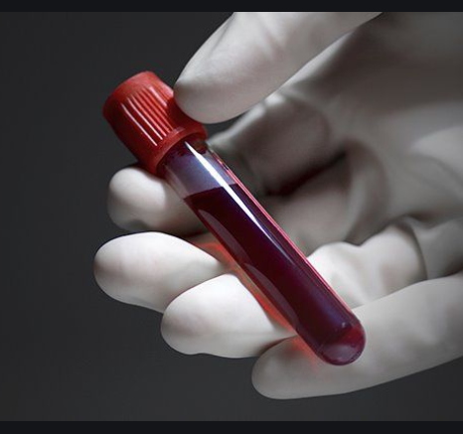

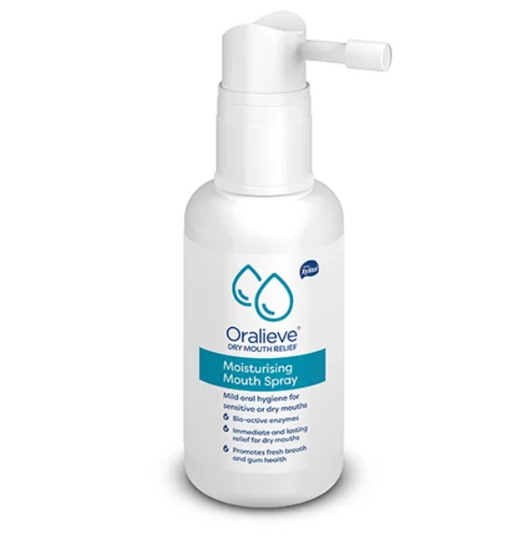
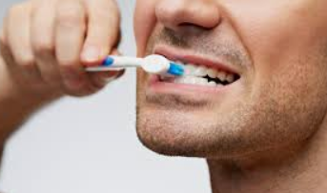
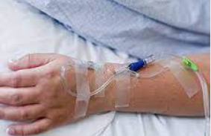
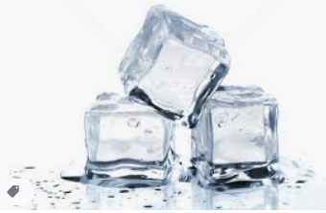
Effectiveness:
Confidence:
5/10
69
Assessment:
25% - All patients
29% - Only PO patients
9% - Only NBM
Staff Survey
63%
14 Interventions
Notes:
Median response to effectiveness of thirst management was 5/10 (range 1-9). Staff reported a median confidence level in treating thirst as 5/10 (range 2-9). 25% (n=17) of staff reported they routinely ask about patient thirst regardless of intake status, 29% (n=20) only ask if the patient can drink, 9% (n=9) only if the patient is nil by mouth (NBM). Fourteen interventions were reportedly used to manage thirst; most frequently used for NBM patients were use of oral swabs (96%, n=66), saliva gel/spray (68%, n=47) and lip balm (63% n=62%). For patients on oral fluids, additional oral fluids (77%, n=53), ice cubes (53% n=29) and lip balm (41% n=28) were most frequently used. Only 1 respondee reported they would not act if a patient was thirsty. Proposed improvements to thirst management included easy access to ice, alternative options to oral swabs, better differentiation between oral hygiene measures and thirst management and balancing of safety and comfort when treating thirst.

Slide 9
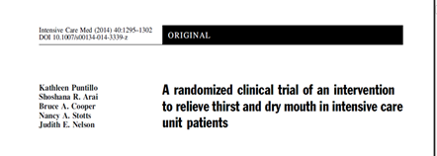
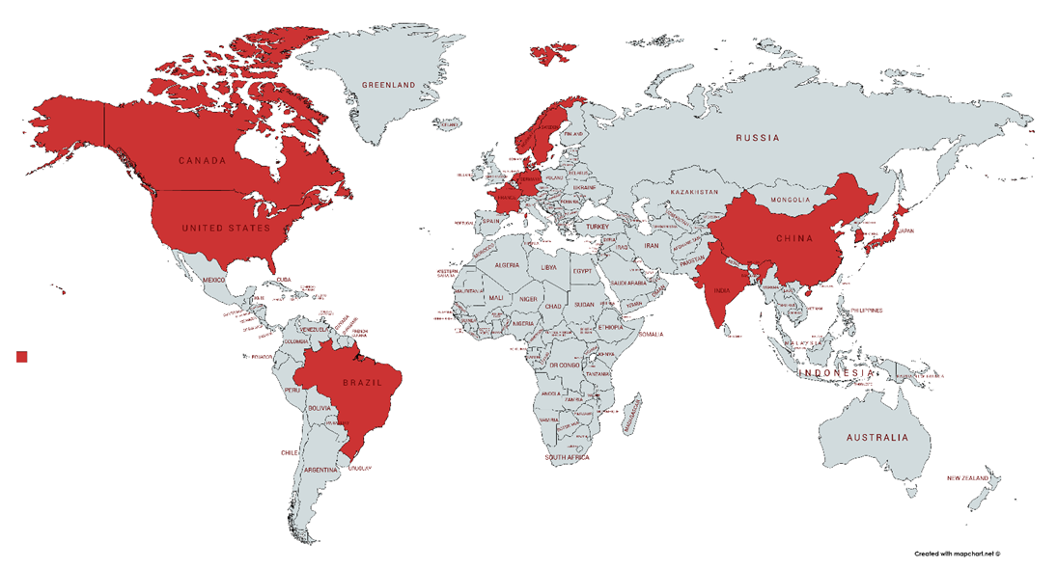
The Evidence Base

Slide 10

Patient
experience
Chronic conditions
Pre/post op fasting
Thirst interventions
Pathophysiology of thirst
Thirst risk factors and drivers
Delirium and thirst
Expert opinion/ advisory
Thirst evidence
Notes:
Slide 6: Evidence
Recently completed a systematic review into the scope and quality of evidence related to thirst treatment in acute care
A number of countries are generating work on thirst
The themes in the evidence are listed on the slide
Scandinavian countries – predominantly generated qualitative/ patient experience work
Brazilian research group looking at thirst in heart failure patients
Pre/post op fasting – china and India
Expert opinion USA/Canada

Slide 11
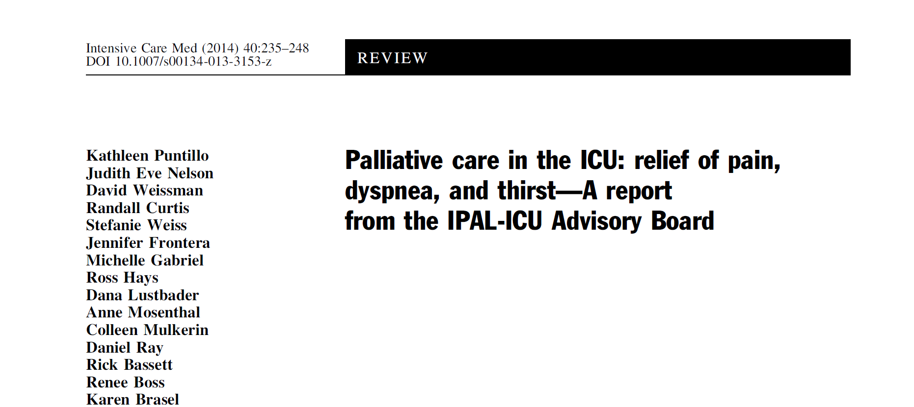
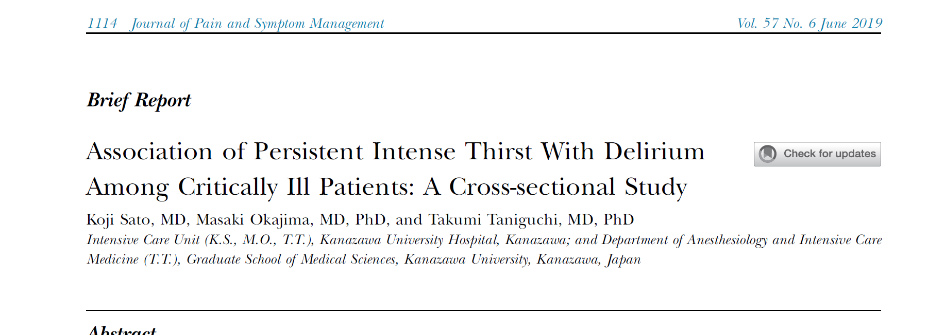
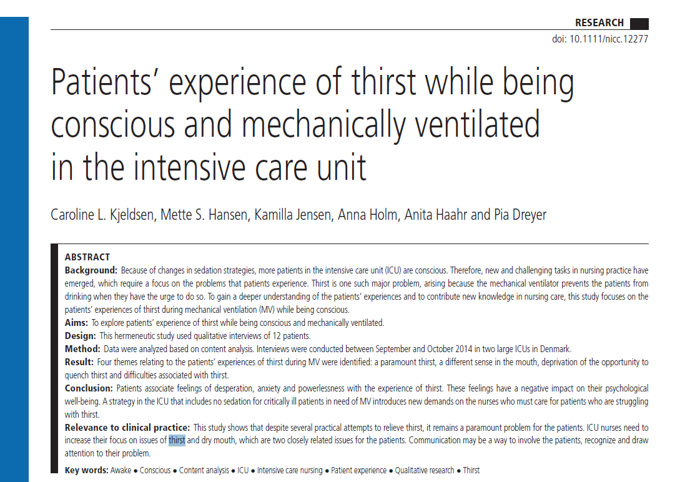
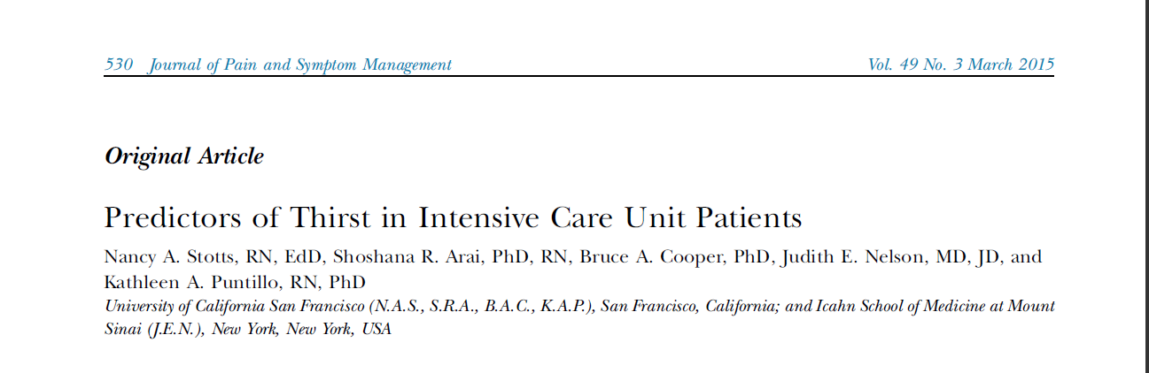
Expert opinion
Delirium and thirst
Patient
experience
Thirst risk factors and drivers
Notes:
Kjeldsen – small sample of 12 patients, Three of the participants had a tracheostomy, and the remaining nine had been extubated within 24 h of being interviewed. Paper concludes that Patients associate feelings of desperation, anxiety and powerlessness with the experience of thirst. These feelings have a negative impact on their psychological well-being. A strategy in the ICU that includes no sedation for critically ill patients in need of MV introduces new demands on the nurses who must care for patients who are struggling with thirst.
IPAL board – interdisciplinary Advisory Board of the Improving Palliative Care in the ICU(IPAL-ICU) Project brings together expertise in both critical care and palliative care along with current information to address challenges in assessment and management. Make an analogy between inadequate symptom assessment and management and errors compromising patient safety.
Decide thirst, dyspnoea and pain are the three most distressing, prevalent and intense symptom of ICU admission and recommend a topical intervention using cooling and menthol to relieve thirst
Stotts paper – cross sectional design to correlate a range of bio-chemical markers, treatment variables and patient characteristics with thirst presence and symptom severity. They find a very varied range of factors correlate – from MV, high sodium, NBM status, furosemide, high opioid dosage, negative fluid balance – demonstrating the complexity of drivers for thirst in CC patients
Sato – new paper from Japan – work in a unit with a thirst management plan in place - ice and ice-cold water sprays, application of lip and oral moisturizers, and maintaining appropriate fluid volume. They predicted that patients with intense thirst would be at risk for delirium. On the basis that Adequate pain management and promoting sleep-wake cycles are key to effectively treating patients at high risk for delirium in the ICU setting. It is also important that any other sources of stress experienced by patients should be assessed and managed appropriately.
40% of patients complained of a strong sensation of thirst during their ICU stay. If intense thirst did not resolve and persisted for more than 24 hours, it was significantly related to delirium.

Slide 12
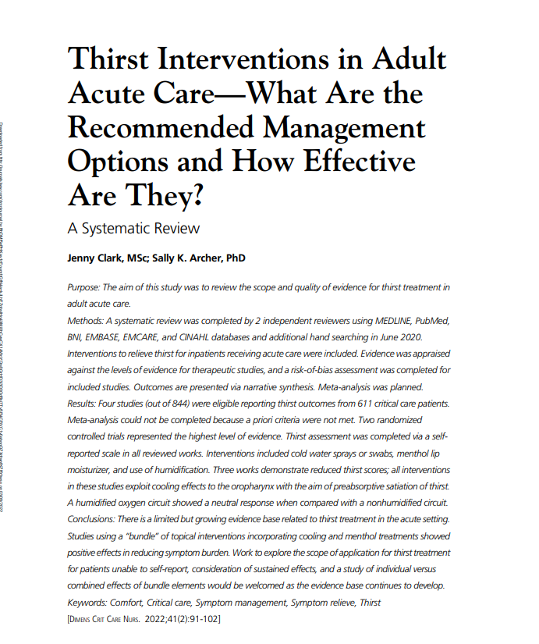
Thirst evidence

Slide 13

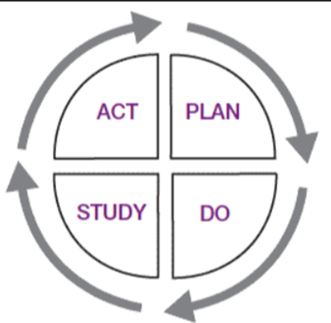
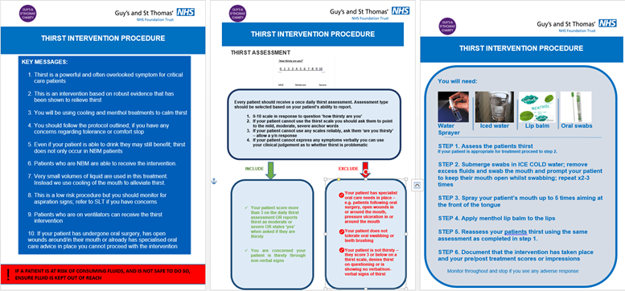
Thirst Solutions

Slide 14
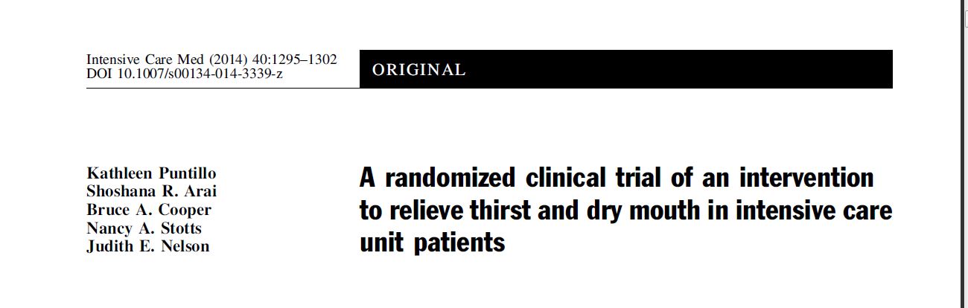
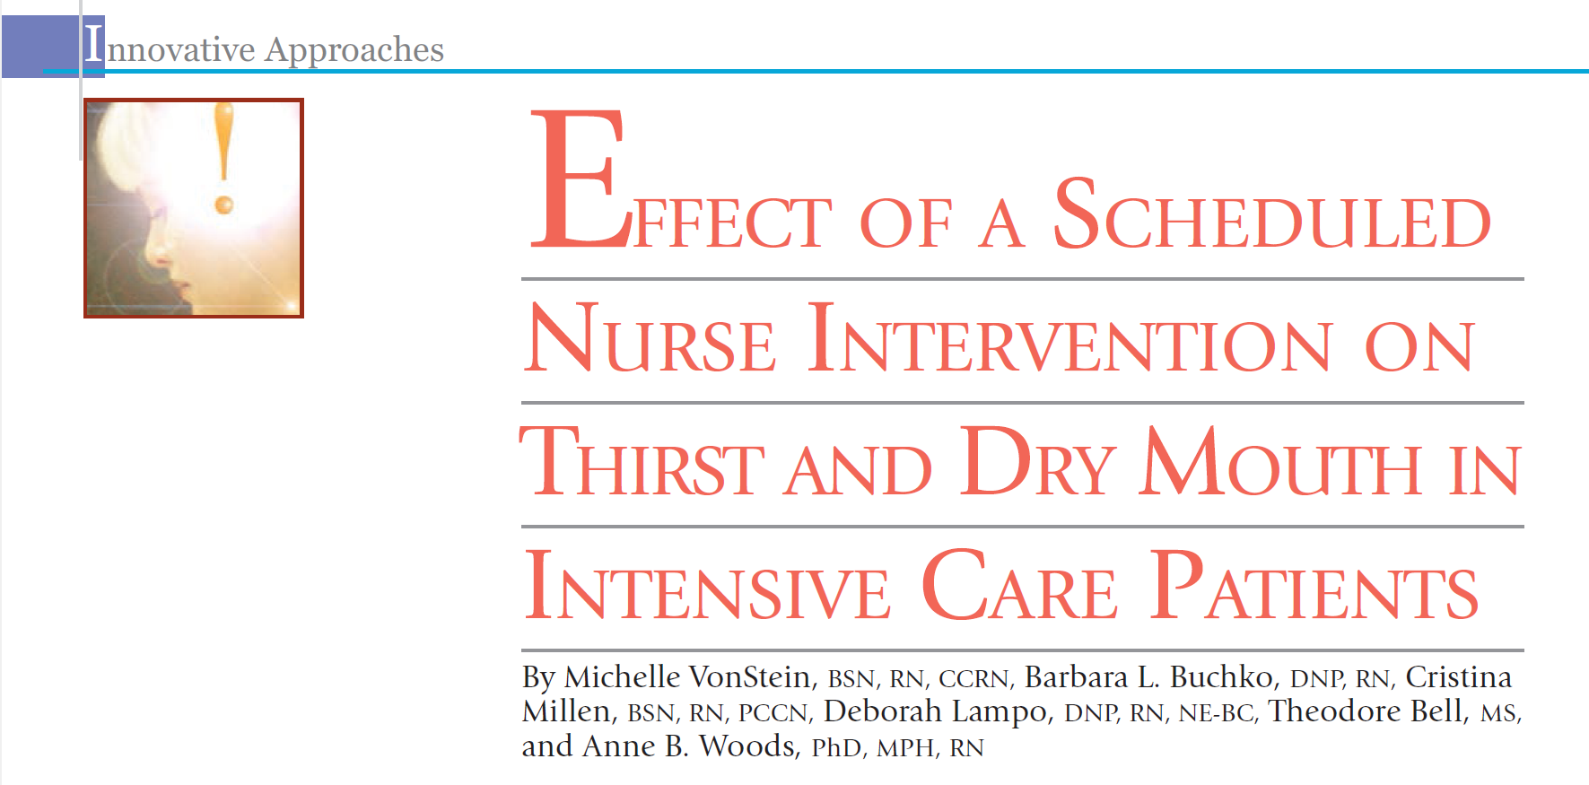
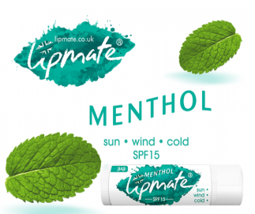
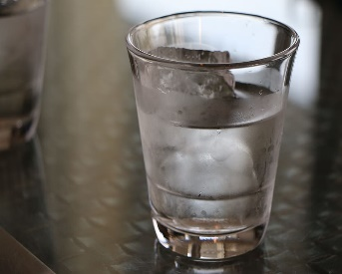
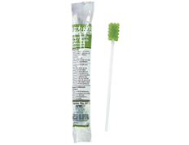
Thirst interventions
Notes:
Big hitters from eat coast and west coast of America
Both assess a thirst bundle on mixed cohort of ICU patients
Both show considerable reductions in thirst using a thirst intervention.
Puntillo uses iced swabs, sprays and a menthol moisturiser twice daily
Von Stein in New York used iced swabs and moisturiser either on the patients request or scheduled hourly
Very convincing account of effects of such a bundle
What is less clear is who it should be applied to clinically – only patients who were able to symptom report were included in these studies
How long effects last – either immediate assessment or maximum assessment period of 2 days – unsure how this will translate to our complex longer stay patients

Slide 15
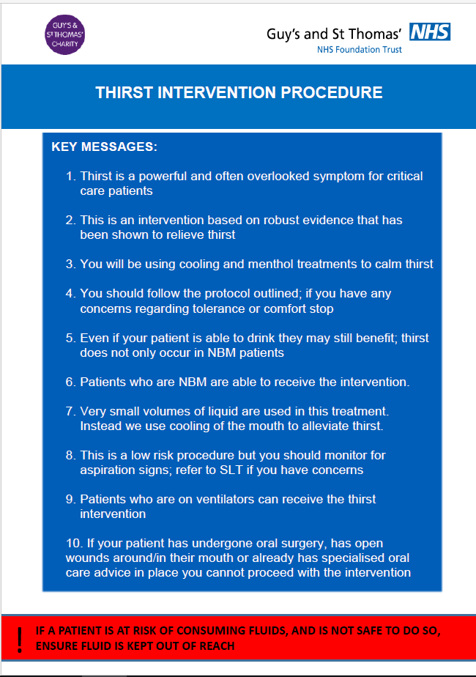
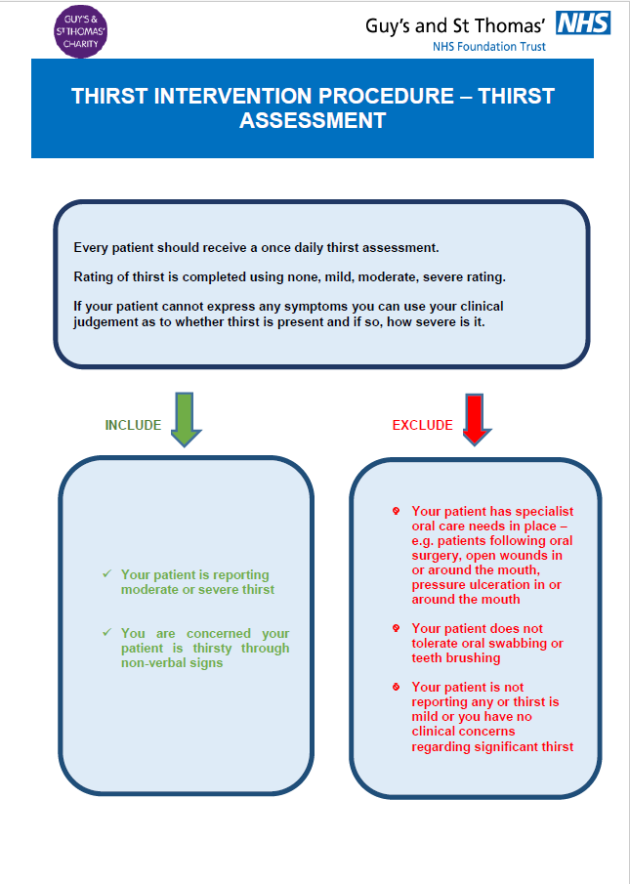
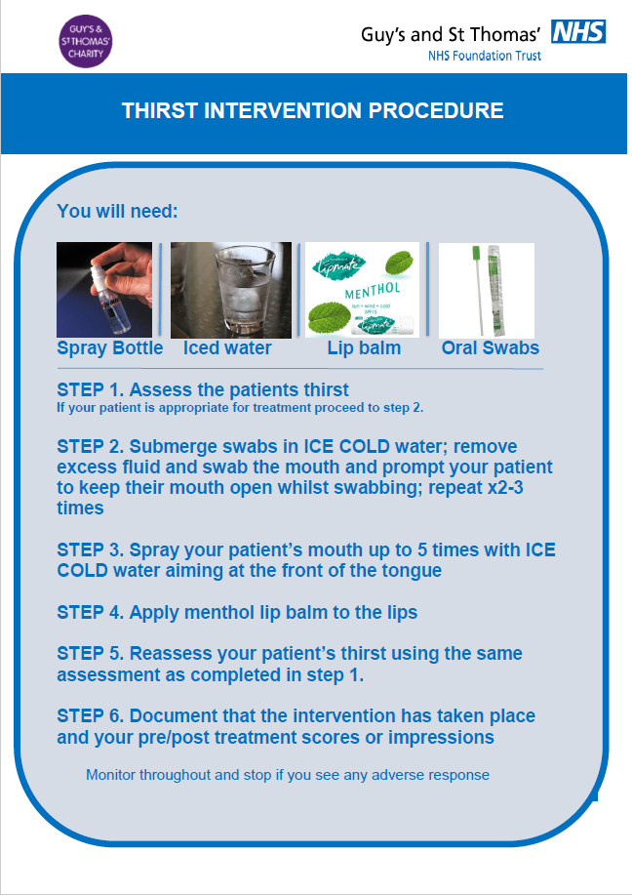
Notes:
Long form PLUS FAQ and pathway

Slide 16
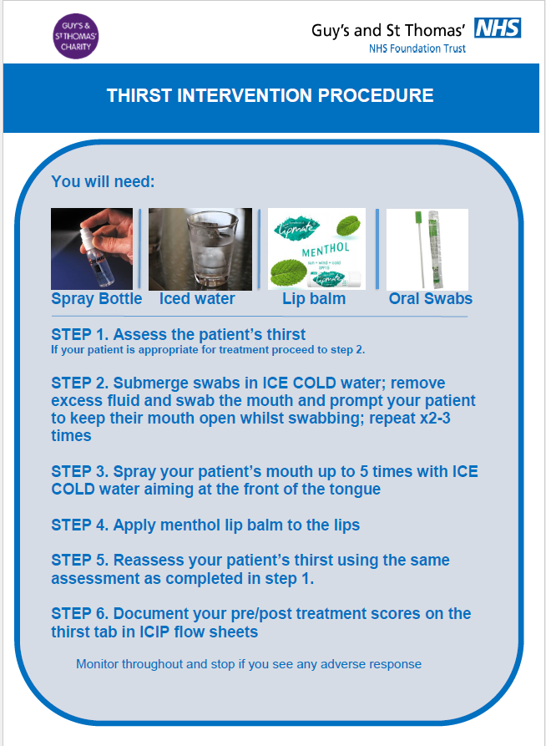







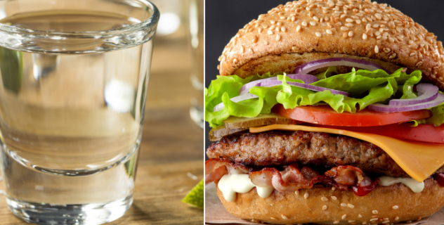
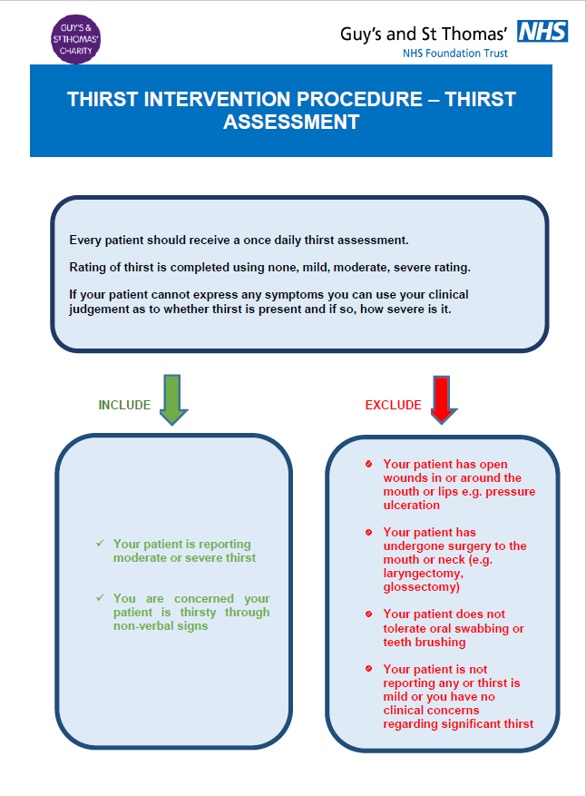
GSTT THIRST BUNDLE – Level 3 Pilot results
105 Thirst Ax
TRACHE
ETT
OWN
Airway
Status
11
5
20
25 days
89
NBM
Fluids
E+D
MEDIAN LOS
Intake
Status
82
12
11
+
Significant thirst (moderate or severe): 61% (n=64)
Outcomes Post Thirst Bundle:
-
0%
29% (n=21)
71% (n=52)
No significant thirst (mild or none): 39% (n=41)
X
Attrition: 23% (n=22)
Worse
Same
Better

Slide 17

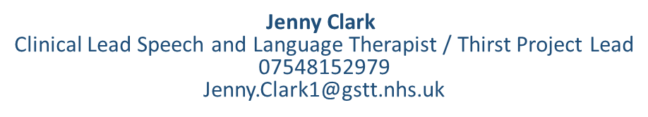
Feedback / reflections/ thoughts…

