Slide 1
President’s Report
2020 Autumn Council Meeting
26 September 2020

Slide 2
Report outline
Topics | Key points
Changes to EfCCNa plans | Council meetings 2021 Board of Officers elections
EfCCNa COVID-19 strategy | Education, C19 SPACE Research Policy
WFCCN | CONNECT journal International Emergency Code

Slide 3

Changes to EfCCNa plans
Council meetings 2021
  Spring 2021 Skopje, North Macedonia
    Potential dates April 10/11th, 17/18th, 24/25th
  Autumn 2021 Utrecht, Netherlands
    22-25th September at congress
(If meetings not possible due to COVID-19 restrictions – virtual Zoom)
Board of Officers elections
  Postponed, not cancelled, therefore nominations still stand

Slide 4
Election nominations
President has served 2 terms of office – standing down
  Nominations were Anna, Colette (accepted)
Board Member (congress) served 1 term of office – can be re-elected
  Nomination was Elin (accepted)
Treasurer has served 2 terms of office – standing down
  Two nominations proposed for Treasurer, but not accepted
  Nominations are open again – speak or send to Drago by end October
  Nominations will be circulated to Council Nov/Dec

Slide 5
= 1-year of office remaining of the 2nd term
Vice President
Anne
Secretary
Colette
Board member
Karen
PRESIDENT
Bronagh
TREASURER
Drago
Board member (congress)
Elin
Anne
Colette
???
Elin
Co-opt
Co-opt

Slide 6
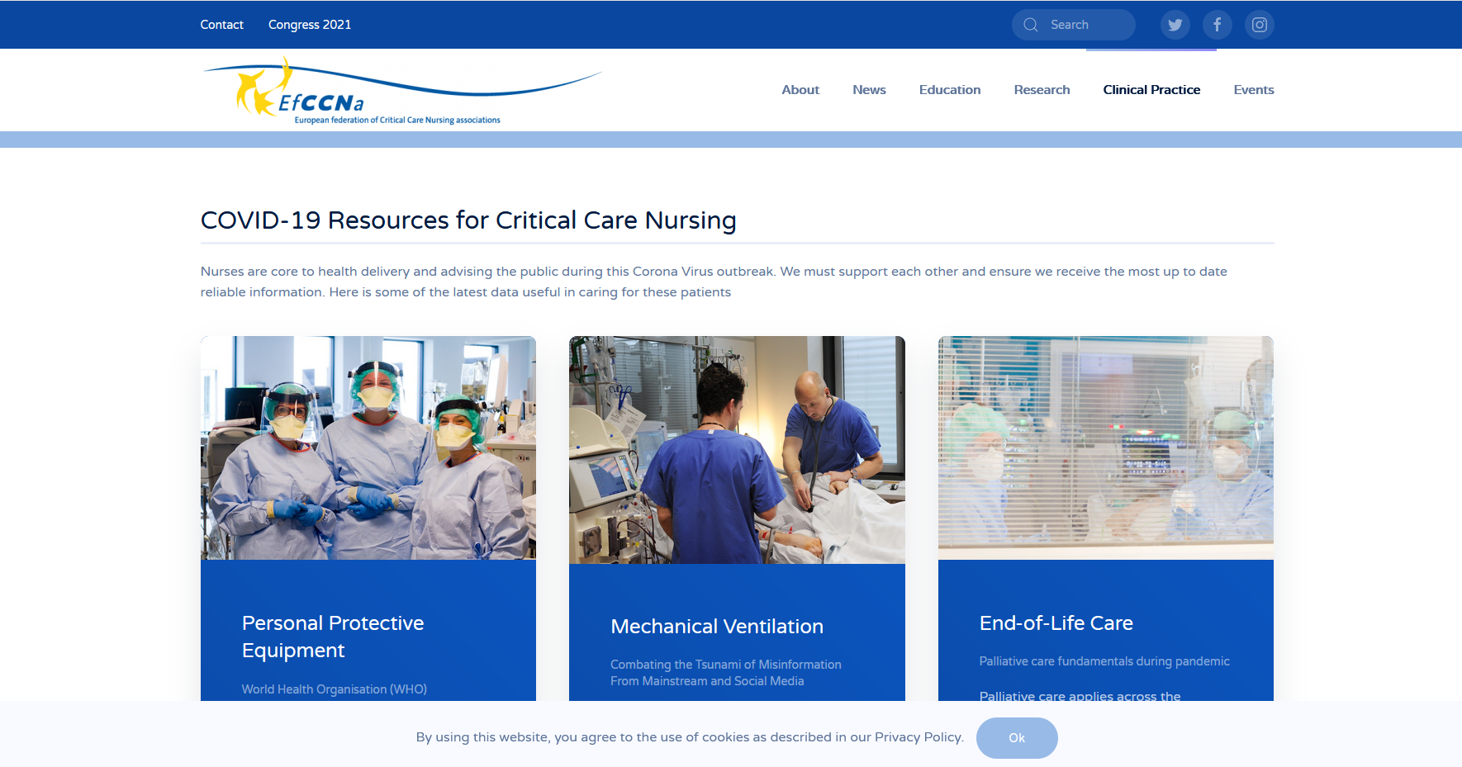
EfCCNa COVID-19 strategy - education
WhatsApp – EfCCNa COVID-19 led by Ian Naldrett
Irene Harth took over organisation of the COVID-19 web pages aided by Anne Kokko

Slide 7
C-19 SPACE - EfCCNa urges participation
The training programme is cost-free & will run from October to December 2020
Trainers and participants receive an Educational Tool Kit in their local language
  Personal safety, donning and doffing of PPE in times of COVID19
  Introduction to ICU
  The ICU Patient: General Aspects & Admission Sequence
  Basics of respiratory support
  Basics of hemodynamic monitoring
  Sepsis and infections
  Other Aspects of ICU Care
  Team care
Further information at https://www.esicm.org/covid-19-skills-preparation-course/#1599827968328-95d75292-d643

Slide 8
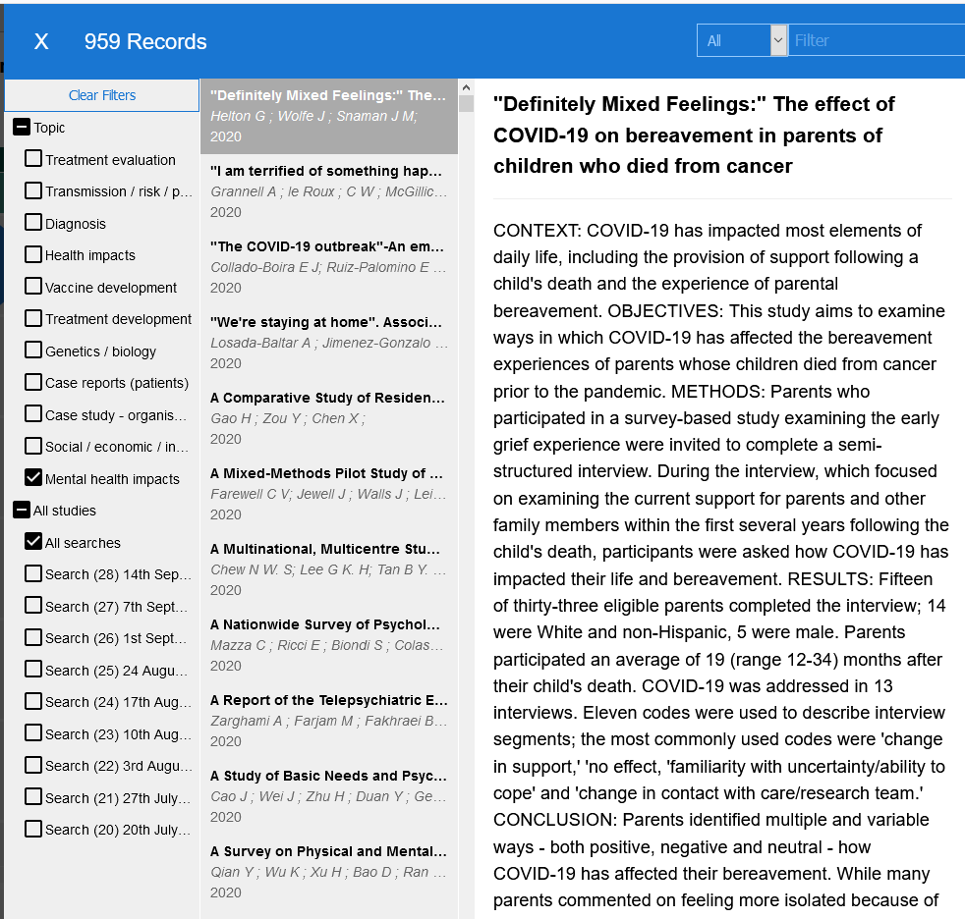
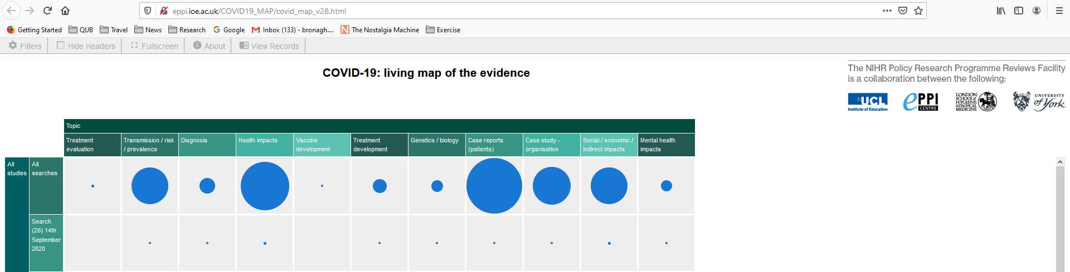
EfCCNa COVID-19 strategy - research
http://eppi.ioe.ac.uk/COVID19_MAP/covid_map_v28.html
Increasing requests for EfCCNa participation or for EfCCNa member recruitment or survey links on web
Julie Benbenishty has agreed to lead the research group & coordinate these requests with support of the research group

Slide 9
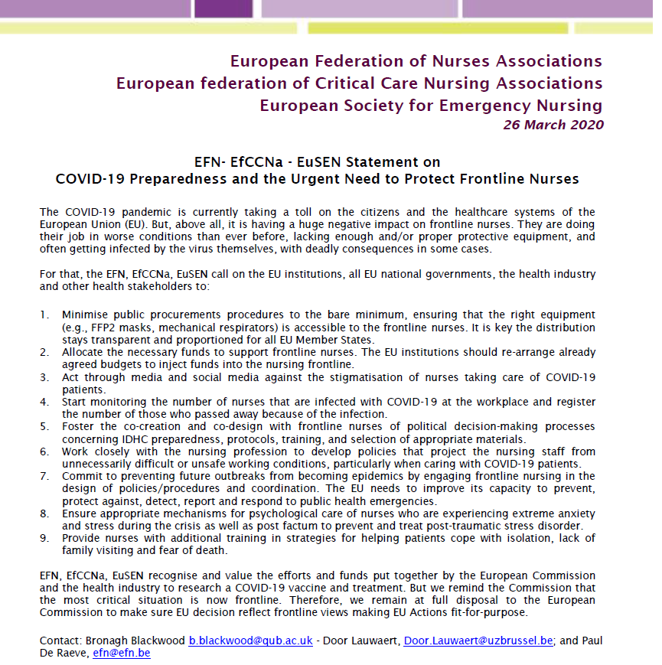
EfCCNa COVID-19 strategy - policy
We subsequently submitted questions to the EU commission about:
mechanism for long-term collaboration
willingness to engage with the nursing profession
support for frontline nurses (mental health)
establishing a political and technical dialogue
Invited to attend a European Commission meeting with representatives from Member States of the EU (jointly with Ministries of health and industry), and five other countries including UK, on the issue of PPE to be used in the context of the COVID-19 pandemic
Important that our specialist skills are recognised – need to work closely with ESNO to achieve this

Slide 10
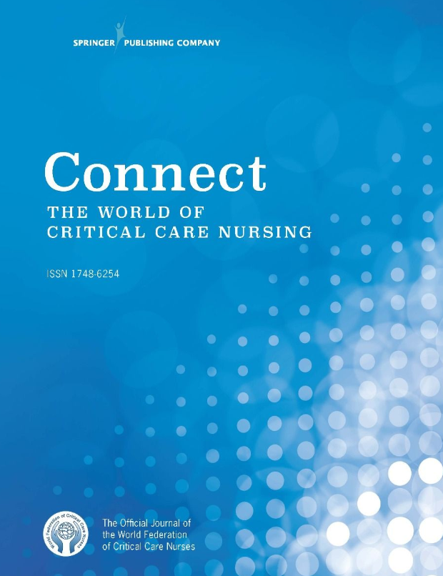
EfCCNa support of WFCCN – CONNECT
Open access - free to members of WFCCN member societies - published quarterly.
Elizabeth Papathannassoglou and Ged Williams – Editors
Seeking greater engagement of EfCCNa in all aspects of the journal
  Associate editors
  Editorial board
  Reviewers

Slide 11

International Hospital Emergency Code
Some countries standardise emergency/cardiac arrest code numbers for hospitals to a single agreed number. Many have none.
  Japan, 360 different numbers; Australia, 51; Spain 51; Netherlands 46,
  Denmark - only 50% of HCW could knew their emergency code
Anecdotal stories of panic and delay associated with lack of recall
International Patient Safety movement to encourage countries to adopt 2222 as the standard - growing number of international healthcare organizations are supporting the call.

Slide 12
EfCCNa support and endorsement
WFCCN -establish a group to critique, review and refine the position statement; participate in writing a review paper on the topic for CONNECT to defend/justify the statement
Two knowledgeable/capable members who are interested in patient safety to join the group
EfCCNa will endorse the final statement

Slide 13

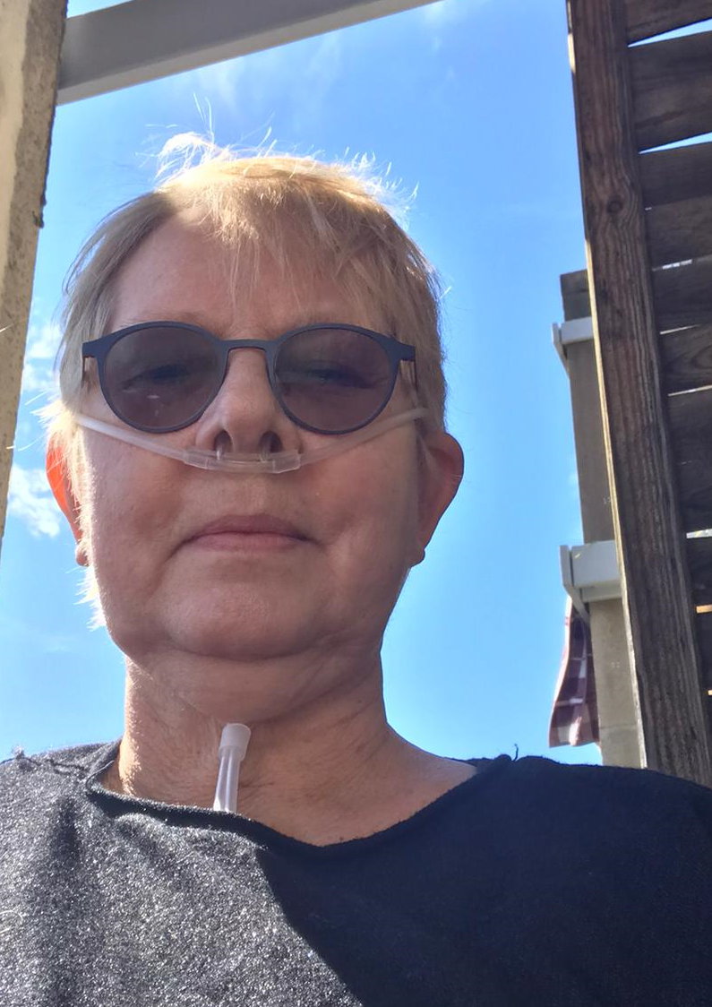
Finally…a massive thank you
…for your fantastic hard work and commitment to patient care during this COVID-19 pandemic. Together, as a federation of 31 associations, we will help each other:
  In promoting frontline nurses politically
  Empowering nurses through provision of sharing educational opportunities
  Supporting research that improves lives
Patients and their families depend upon us & we have our own Eva who will testify to that...xxx

