Slide 1

Annual General Meeting
October 2025

Slide 2
Annual General Meeting of the British Association of Critical Care Nurses
October 2025
Agenda
  Welcome and introductions
  Receipt of reports from National Chair, Secretary, Financial and Engagement Lead
  Approve accounts of previous financial year
  Elect members of the National Board and appoint officers to replace those retiring
  Consider any resolution or motion duly submitted to the meeting
  Set date for next AGM

Slide 3

BACCN
Chair’s Report
Ian Naldrett
BACCN Chair

Slide 4
Annual General Meeting of the British Association of Critical Care Nurses
October 2025
  What have we achieved?
  Created an action plan to strengthen our organisational governance structure using the NCVO Governance wheel
  Revised and updated policies and procedures
  Embedded an Independent board member role onto the board structure
  Patient and carer involvement strategy in development
  Appointed new editor for our journal
  Increased funding offer to support members’ access to BACCN conference and other events

Slide 5
Annual General Meeting of the British Association of Critical Care Nurses
October 2025
  Future Plans
  Chief Operating Officer appointment to support BACCN Trustees to deliver charitable objectives in an efficient and effective way
  Update and publish our Position statements
  Build a new membership, benefits and marketing strategy to modernise and attract more critical care nurses to BACCN.
  Develop a charitable strategy on supporting international critical care nursing

Slide 6
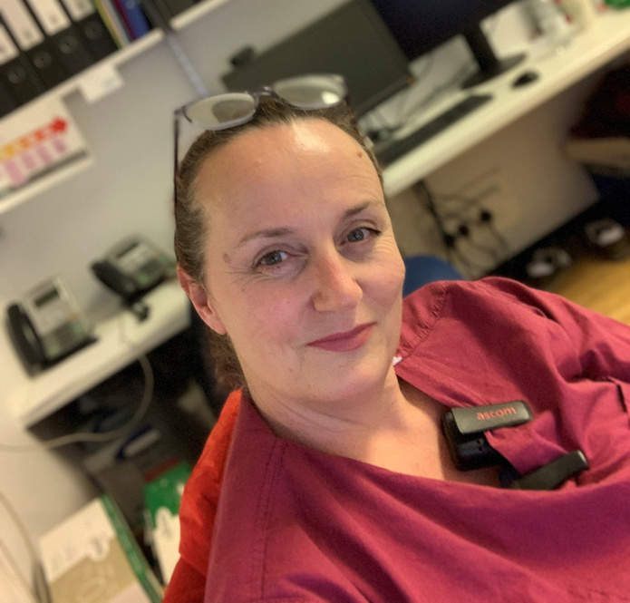
Finance Report
Patricia McCready
BACCN Financial Lead

Slide 7
Annual General Meeting of the British Association of Critical Care Nurses
October 2025
Finance Report – BACCN (Charity)
Income
  Membership fees decreased from £82,280 in 2023 to £79,208 in 2024
  Journal income increased from £113,452 in 2023 to £150,299 in 2024
  Charitable gift aid in 2024 donated to our Charitable Company was £68,562 (£6,720 in 2023).
Expenditure
  Management fees increased from £39,949 in 2023 to £42,047 in 2024
  Governance costs decreased from £8,338 in 2023 to £4,166 in 2024
  Total Support Costs increased from £58,079 in 2023 to £61,966 in 2024
  Journal costs remained consistent with prior year - £39,997 in 2023 to £40,000 in 2024

Slide 8
Annual General Meeting of the British Association of Critical Care Nurses
October 2025
Finance Report – BACCN (Charity)
  Overall, the charity as at 31st December 2024 has total funds of £418,905 compared to £338,017 in 2023.
  We have offered grants to all members to attend our annual conference
  We are going to change our bank accounts to a sustainable provider
  We have produced a financial strategy that will support our membership further
  We have joined the National Council for Voluntary Organisations (NCVO) to help ensure good financial governance

Slide 9
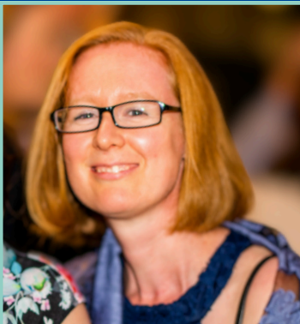
Engagement Report
Nicole Lee
BACCN Engagement Lead

Slide 10
Annual General Meeting of the British Association of Critical Care Nurses
October 2025
Membership Report – BACCN (Charity)
The graph below shows only total active members and how this fits with quarterly membership figures since January 2016. As of 3 June active members stand at 1656. 81 non active CCU members are not accounted for in the below graph bringing total PAID members to 1737.

Slide 11
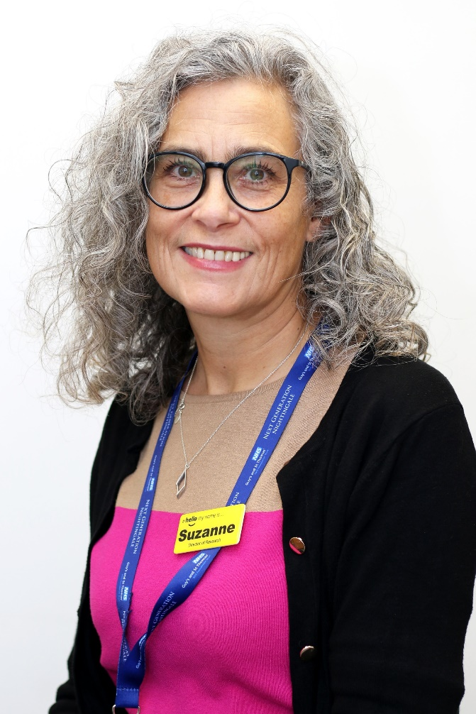
National Secretary
Dr Suzanne Bench

Slide 12
BACCN Executive Board Members 2025-2027
Chair: Ian Naldrett
National Secretary: TBC
Finance Lead: Patricia McCready

Slide 13
National Board Member roles 2025-2027
Professional Advisors: Amy Pulleyn/Latifat Awotedu
Regional Advisors: Filipa Monteiro/Rebecca Sumnall
Conference Lead: Karin Gerber
Engagement lead: Nicole Lee
Research and Academic Advisor : Dr. Louise Stayt
David Waters: Commercial lead
Stephen Cutler: Independent board member (2025-2026)
Supported by ECHO events

Slide 14
Name | Term | Re-election nominations
Trish McCready | 2025-2027 | Stephen Cutler Heather Baid
Karin Gerber | 2025-2027 | Heather Prowse (42690) Mark Wilson (33673)
David Waters | 2025-2027 | Tim Collins. 14815. Natasha Loughrey. 805C
Nicole Lee | 2025-2027 | Judith Harriott (39351) Felicity Chapman (34245)
Amy Pulleyn | 2025-2027 | Louise Stayt (17257) Be Baxter Hayes (42707)
Latifat Awotedu | 2025-2027 | Mark Wilson (33673) Suzanne Bench (13824)
Filipa Monteria | 2025-2027 | Ana Mendonça (43105) Heather Prowse (42690)
Louise Stayt | 2025-2027 | Jody Ede (43455) David Waters (16228)
Stephen Cutler | 2025-2027 | Suzanne Bench (13824) Ian Naldrett (37646)
Notes:
The National Board can consist of up to fifteen Full Members of the Association who are elected by Members at the Annual General Meeting.

Slide 15
Annual General Meeting of the British Association of Critical Care Nurses
October 2025
  Chief Operating Officer appointment
  Purpose: to support the BACCN Chair and other Trustees to deliver charitable objectives in an efficient and effective way
  0.2 WTE for 18 months
  £16,000 PA
  Questions/comments/approval?

Slide 16
Thank you for your attention
Date of next AGM: October 2026

