Slide 1





Our Mission
As a leading non-profit organisation, we are dedicated to the promotion of nursing in critical care through provision & promotion of:
  A national voice to shape the strategy for critical care nursing
  Safe, quality evidence-based nursing care to the critically ill patient
  A wide range of benefits & opportunities to BACCN members
Established 1985
BACCN @BACCNUK BACCNUK BACCN

Slide 2
Some key individual membership benefits include:
Free access to the online BACCN Journal 'Nursing in Critical Care’
Reduced rates at all BACCN study days & conferences
Access members-only awards and grants
Regular e-newsletters keeping you up-to-date with what’s new
Exclusive access to CPD Certified training events and access to online learning materials including videos
Benefit from networking with other critical care nurses in your region
Keep up to date with current practice & new developments - enhance your career
Established 1985

Slide 3
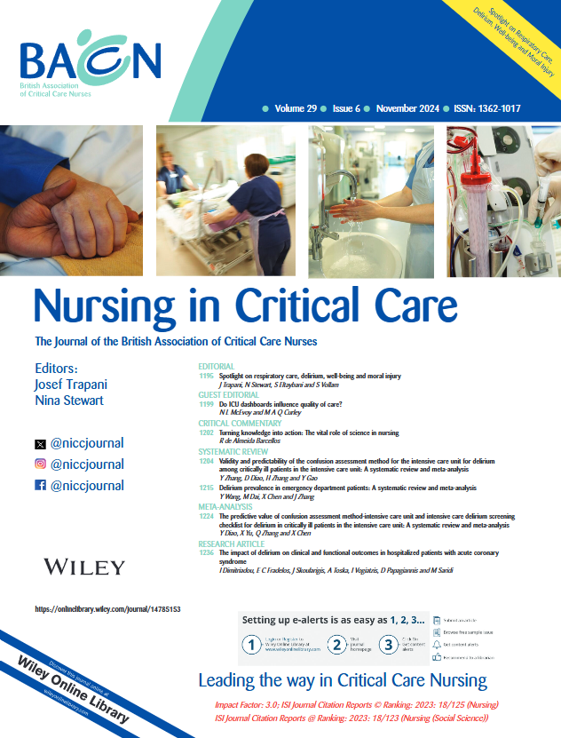
Established 1985

Slide 4

Established 1985

Slide 5
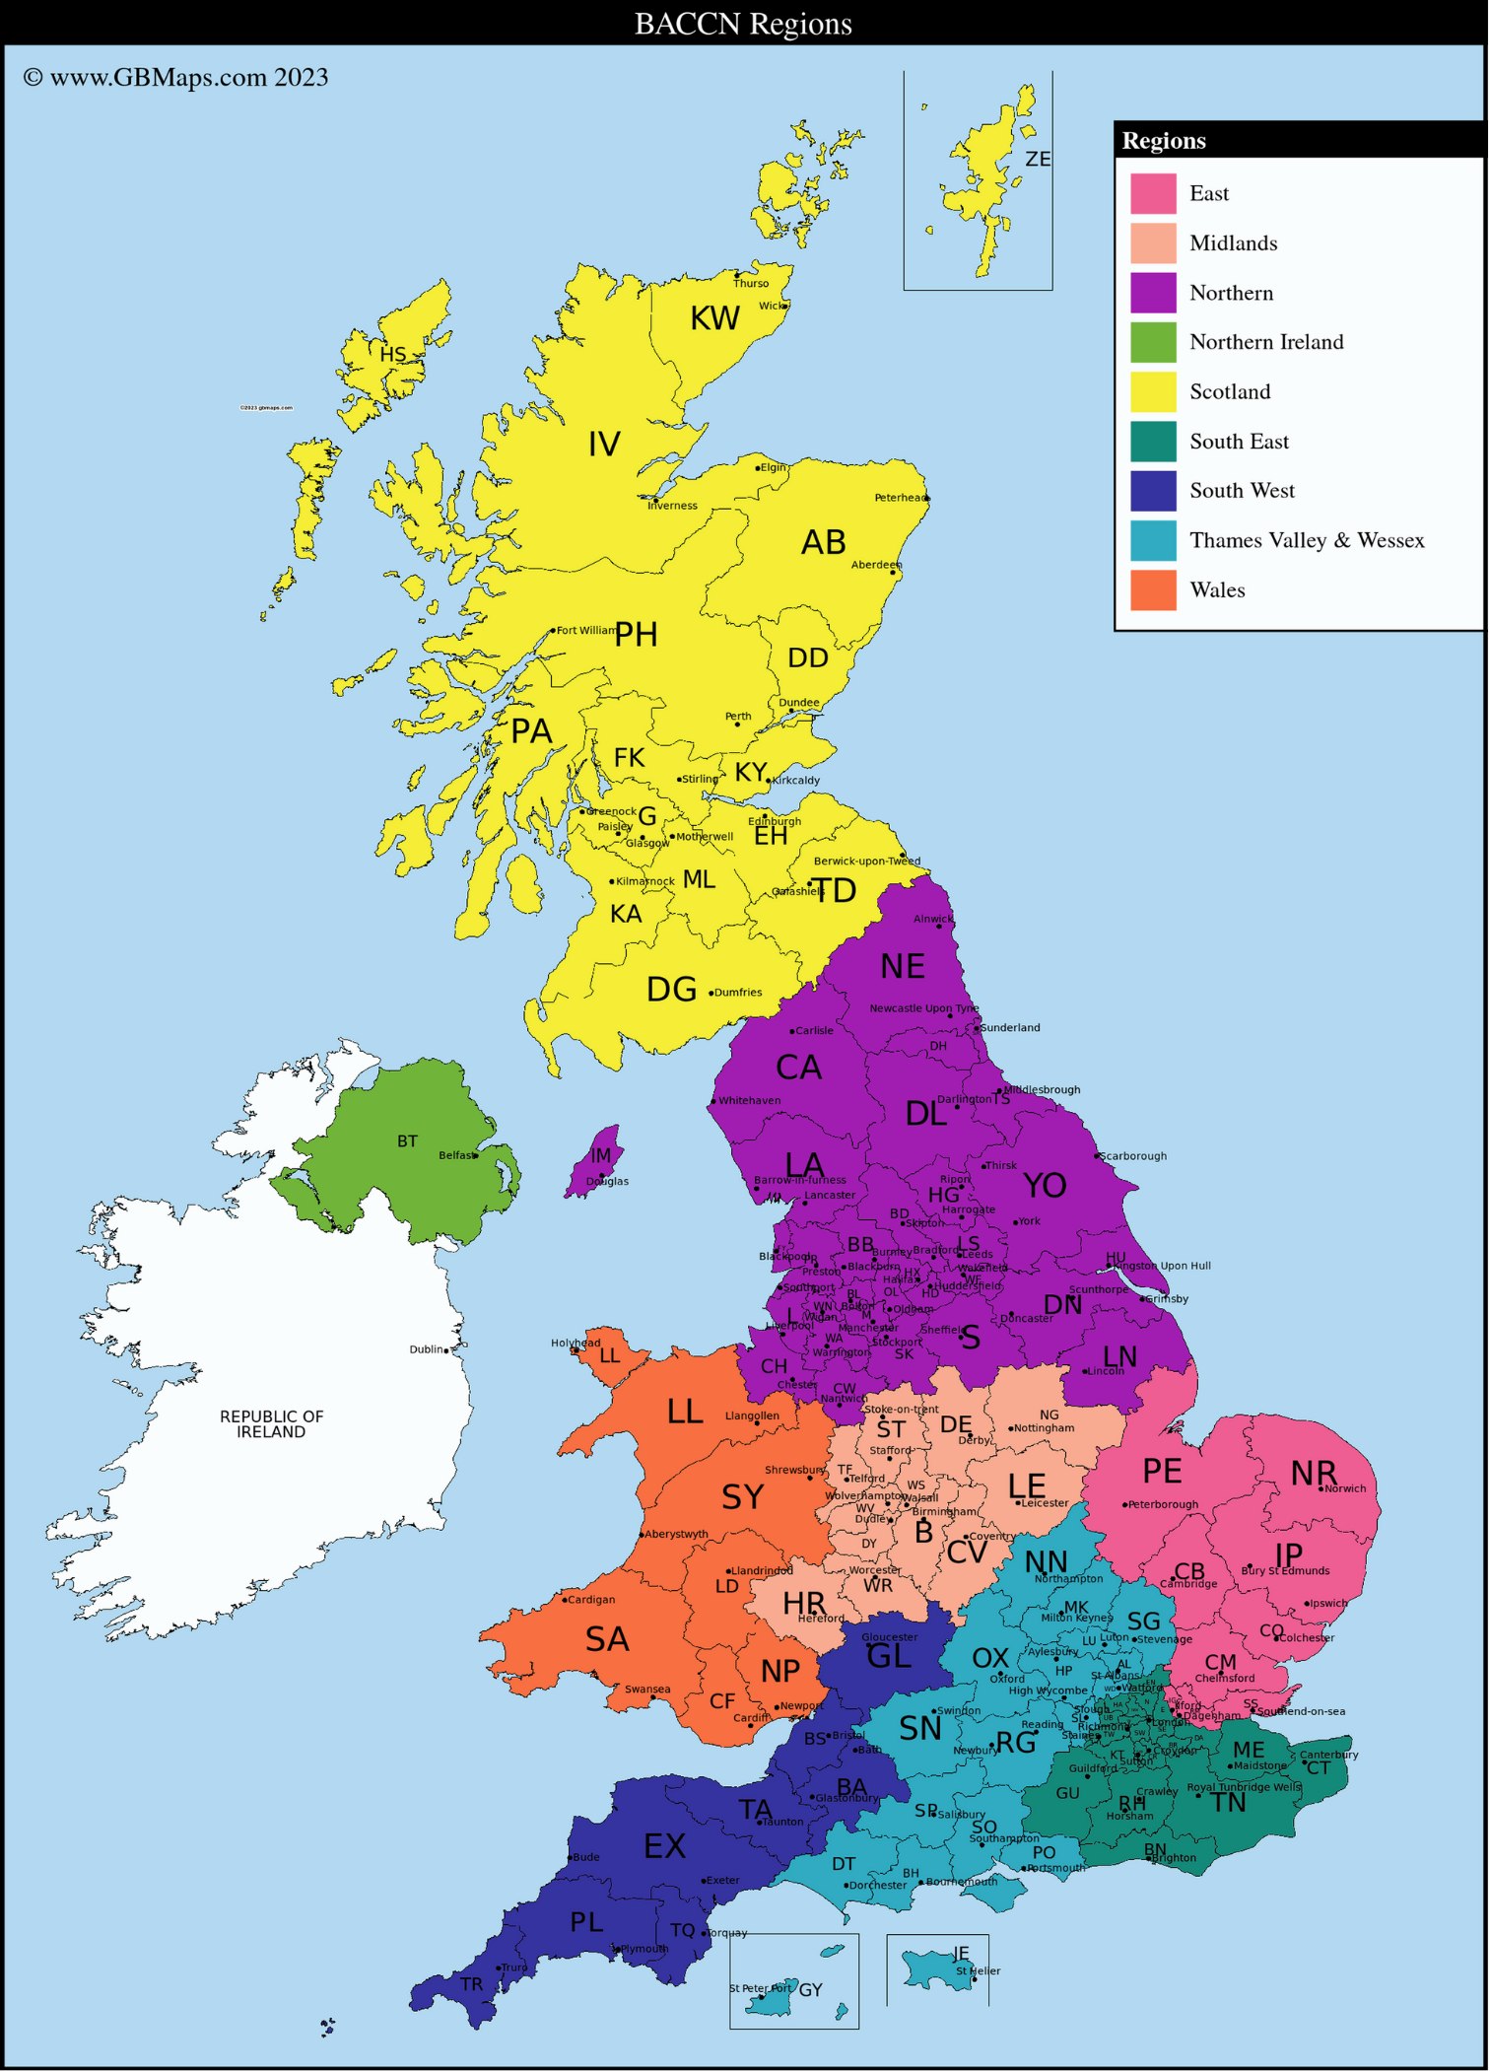

Regional Study Events
BACCN Members attend for free or at discounted rates
Established 1985
BACCN is made up of 9 regions covering the whole of the UK. Each Region has its own Regional Committee of BACCN members who provide support - educational and otherwise - to critical care nurses across their region.
Regional Study Events are held throughout the year, face to face and online.

Slide 6


View recordings of past Study Events and webinars in our members area!
Established 1985

Slide 7

Established 1985

Slide 8

Partner Events
BACCN Members attend for free or at discounted rates
Established 1985

Slide 9

BACCN Grants and Awards
We offer a number of grants and support research
The aim of our grant funding is to enhance skills, knowledge and competence in critical care nursing and to improve patient care and outcomes. We offer a range of funding opportunities:
Event attendance: You may apply for funding for up to a maximum of £1000
Stakeholder Engagement: You may apply for funding for up to a maximum of £1000
Staff Activities: You may apply for funding for up to a maximum of £1000
Projects: You may apply for up to a maximum of £2000
See details of all our grants and awards on the website!
Established 1985

Slide 10
A national voice to shape the strategy for critical care nursing
The BACCN's National Board members and other members represent BACCN and its Members on several professional groups, details of some of these associations are listed here.
Reports from these groups can be found on the website.
Established 1985
Board Member | Group
Ian Naldrett | Critical Care Leadership Forum
Suzanne Bench | UKCCNA
Suzanne Bench & Louise Stayt | UKCCRG ANNCCR
Nicole Lee | EFCCNA
Louise Stayt | CC3N National Critical Care Competency and Education group
Amy Douglas Latifat Awotedu | Organ Donation Committees
Trish McCready | The UK Health Alliance on Climate Change
Ian Naldrett & David Waters | Cardiac competencies for National Critical Care Competency and education group

Slide 11
Position Statements & National Guidance
The BACCN aims to provide representation for its members, by responding to political and professional change; and by producing and publishing position statements. BACCN position statements intend to demonstrate the Association's commitment to contribute to policy debates and to inform and influence the national agenda on issues that are important to the critical care nursing community.
We are also involved in working more widely with external Organisations in the review and production of documents and standards for critical care which will also be of interest to BACCN Members.
BACCN Statement on Environmental Sustainability
British Association of Critical Care Nurses: Evidence-based consensus paper for oral care within adult critical care units
BACCN statement and advice on staff wellbeing
BACCN Position Statement on non-Medical Prescribing in Critical Care
BACCN Position Statement on Visiting in Adult Critical Care Units in the United Kingdom
BACCN Statement on Social Justice
Established 1985

Slide 12


Get more involved
Established 1985

Slide 13
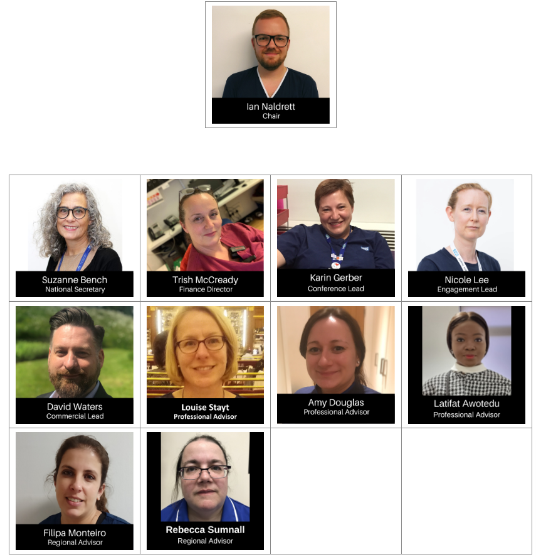
Join the BACCN National Board and help make a difference!
Are you passionate about critical care nursing? Do you want to develop your skills by working at a national level to influence future policy and practice?
We are actively seeking people from all backgrounds to join the National Board team. If you are a current BACCN member and part of a regional committee then please get in touch.
We are particularly keen to receive applications from nurses from under-represented groups.
Established 1985

Slide 14

Established 1985
For more information and to join,
visit https://www.baccn.org/ccu-registration/

Slide 15

Established 1985

