Slide 1
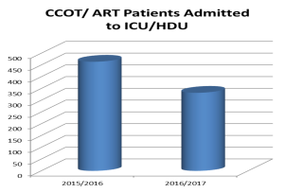
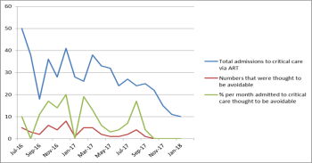
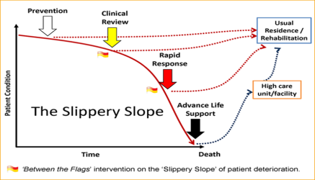
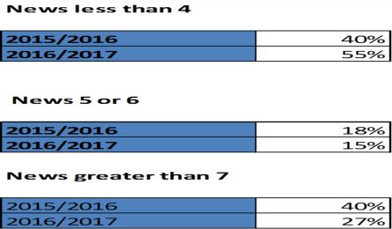
Improving Patient Safety Through Early Detection of Deterioration From Critical Care Outreach to Acute Response
BACCN Conference 2018 17th& 18th September, Bournemouth
By Emma Coutts ART
Medway NHS Foundation trust
Introduction
Mortality and morbidity may be prevented by early recognition of deterioration and prompt resuscitation of sick patients NICE (2007) .
Critical Care Outreach teams were assembled to provide and support the care of sick patients on the ward in line with the Department of Health (2010).
(Fig1)
Critical Care Outreach Medway
9 nurses Band 6-7.
Referrals were taken via bleep system with no clear guidance as to when to refer
The team were based in the Surgical High Dependency Unit.
There was 1 nurse covering the hospital day and night Patients often needed admitting to HDU/ICU.
Why Change
To Improve our patients safety and prevent deterioration.
Ensure we deliver the right care, at the right place at the right time.
Reduce CU/ HDU admission
What Changed
Nice (2007) Recommend a set of clear guidelines for escalation
The team was expanded to 12 whole time equivalents.
2 nurses covering both day and nights with a 3rd nurse covering the busiest time of the day between 18:00-02:30.
The team led by 3 Band 8 Advanced Clinical Practitioners.
Staff using NEWS expected to refer any patients who scored above 4 in total or 3 in one single observation
The ART team would aim to review the patients referred as follows:
Patients with NEWS ≤ 4 –
within 60 minutes
Patients with NEWS ≥ 5 –
within 45 minutes
Patients with NEWS ≥ 7 – immediately
Patients with new AKI 2 or 3 - within 4 hours
Patients with Sepsis suspected -
within 30 minutes
Critical care step-down patients should be reviewed within 4 hours of discharge from any critical care unit and 12 hourly for 36 hours
Any patient who has a NEWS ≥ 7 needs escalation to a senior clinician and should be referred to ART or a Foundation Doctor to an SpR 24:7.
Any patient who is failing to respond to a response team plan after 4 hours should be escalated to the appropriate speciality Consultant 24:7 by the ART or speciality SpR
Tackling a storm one drop
at a time
Conclusion
The new guidelines and emphasis on early intervention has improved patient safety by decreasing deterioration and averted critical care admissions.
1St Year review
What Next
Advanced nurse practitioners.
Clinical practice at Advanced Level
Management
Clinical Leadership
Education and Research.
What it Means
Improved treatment time to diagnose and treat patients
Higher skilled
Holistic Care
National Institute for Clinical Health and Care Excellence (2007) Acutely ill adults in hospital: recognising and responding to deterioration https://www.nice.org.uk/Guidance/CG50 Accessed 23/05/2018,
Fig 1 http://www.cec.health.nsw.gov.au/patient-safety-programs/adult-patient-safety/between-the-flags Accessed 23/05/2018

